Slide 1
Chapter 10
Simple Machines

Slide 2
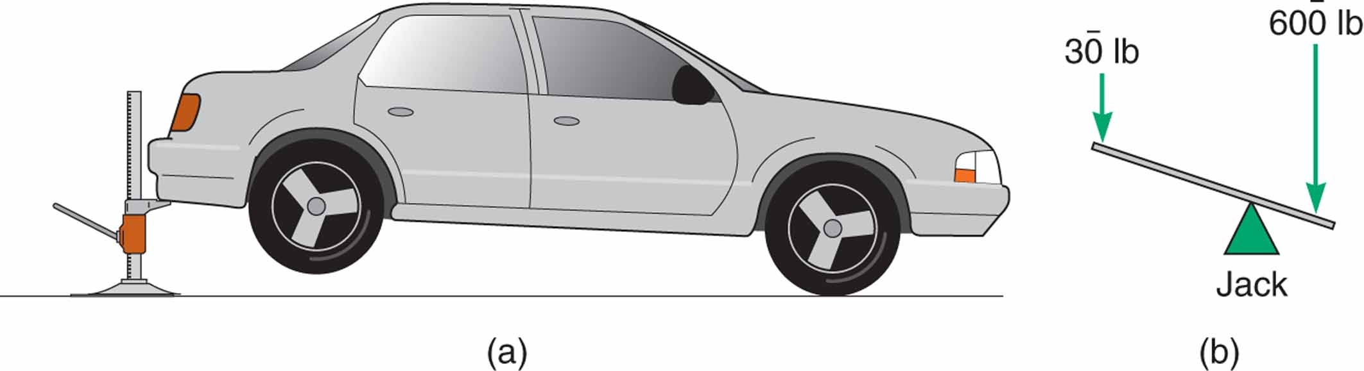
Figure 10.4 This lever multiplies force.

Slide 3
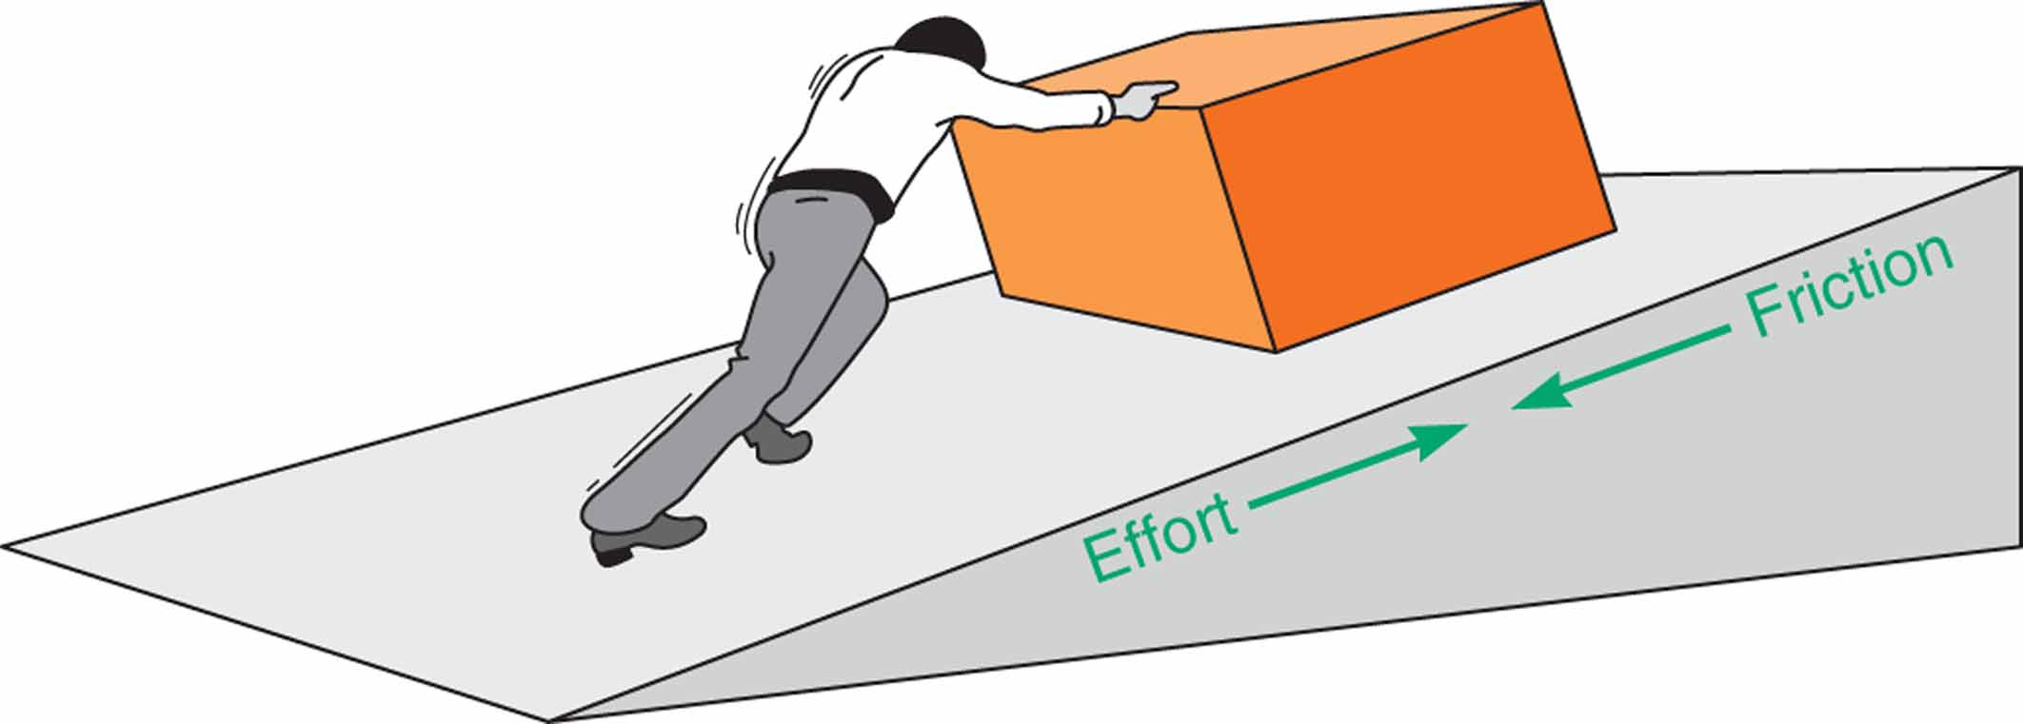
Figure 10.5 Some work is always lost to friction.

Slide 4
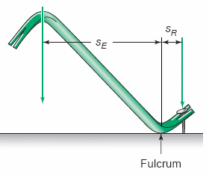
Figure 10.6 Mechanical advantage of lever: MA= SE/SR

Slide 5
Figure 10.7 Three classes of levers

Slide 6
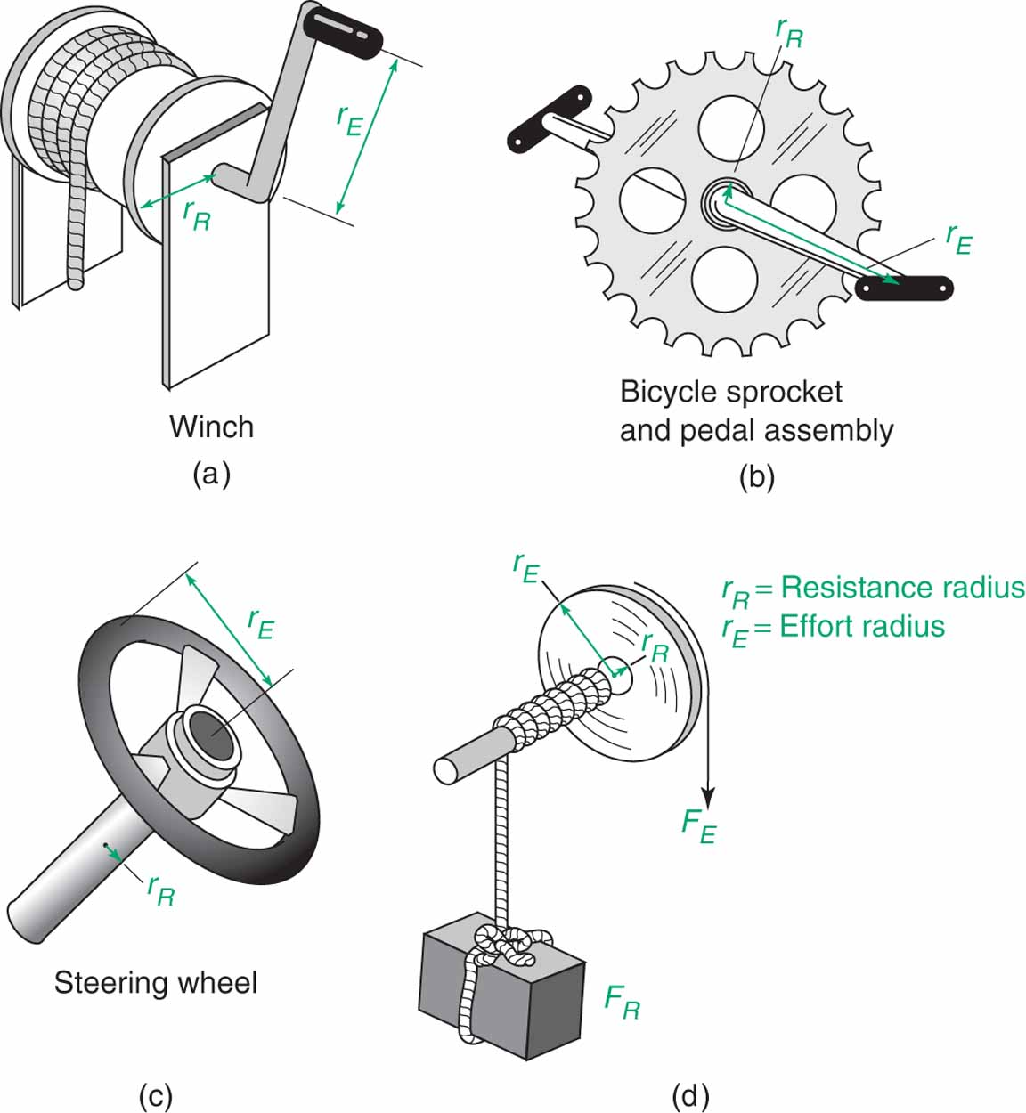
Figure 10.11 Examples of the wheel-and-axle

Slide 7
Figure 10.13 Pulleys and pulley systems

Slide 8
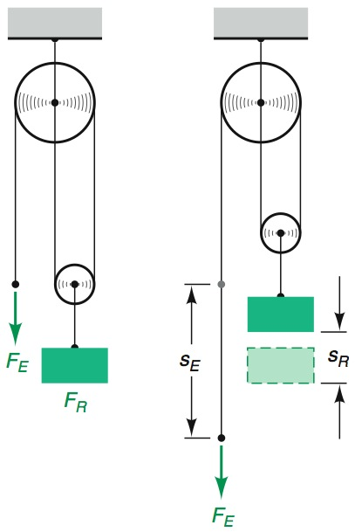
Figure 10.14 Law of simple machines applied to pulleys: F_{R} • s_{R} F_{E} • s_{E}

Slide 9
Figure 10.15 Mechanical advantage of pulleys and pulley systems

Slide 10
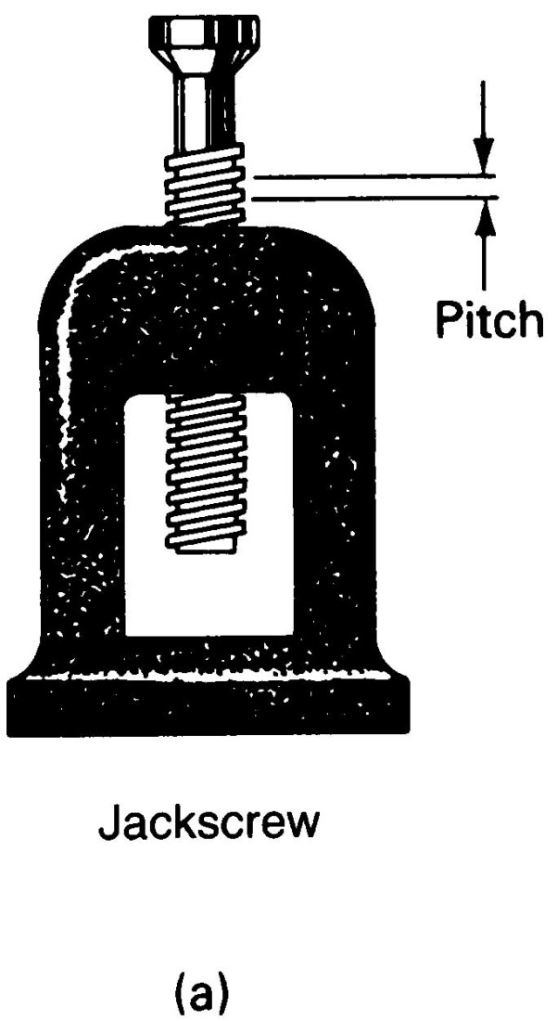
Figure 10.20 Examples of screw-type simple machines.

Slide 11
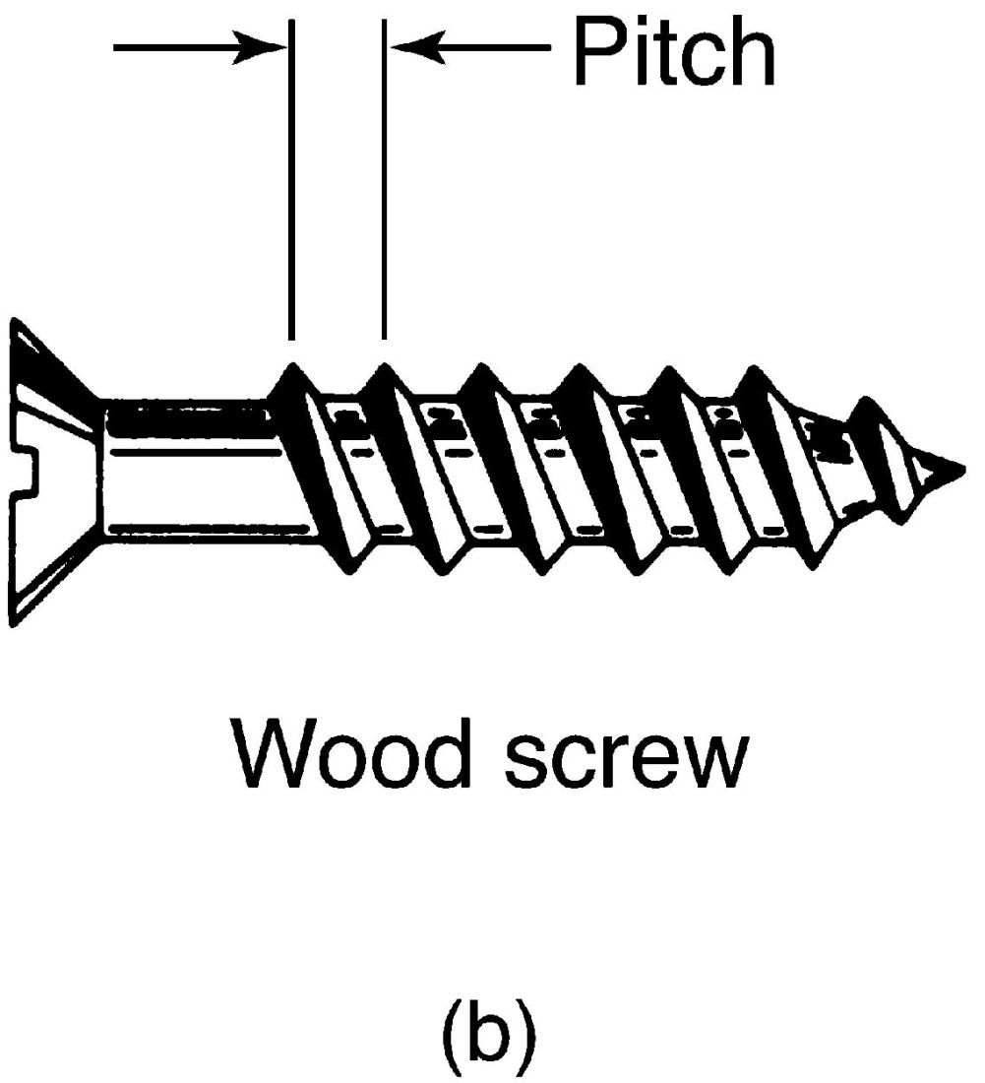
Figure 10.20 (continued)

Slide 12
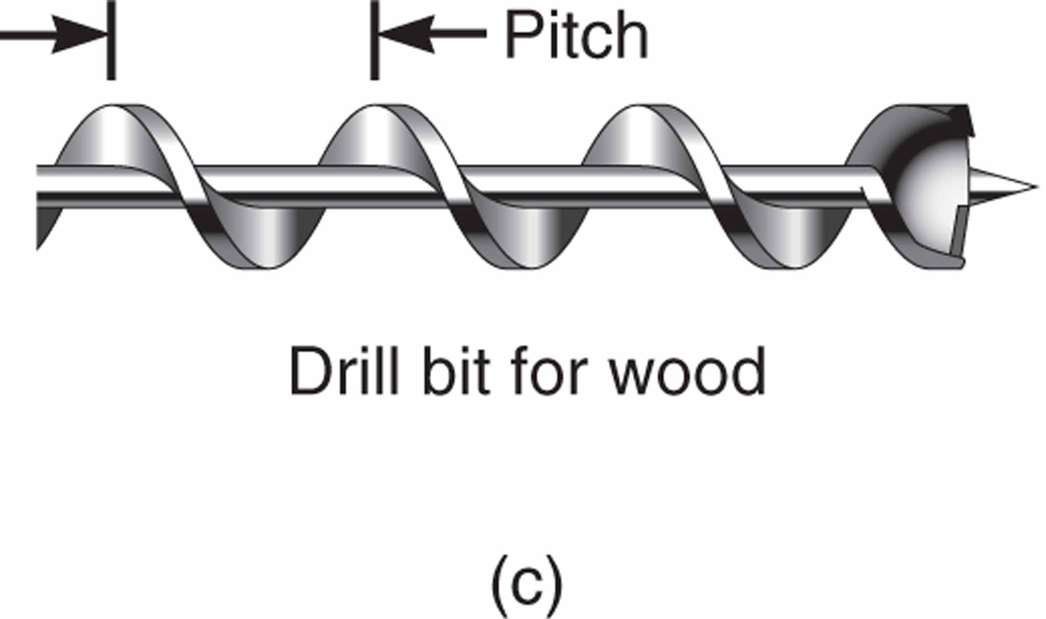
Figure 10.20 (continued)

Slide 13
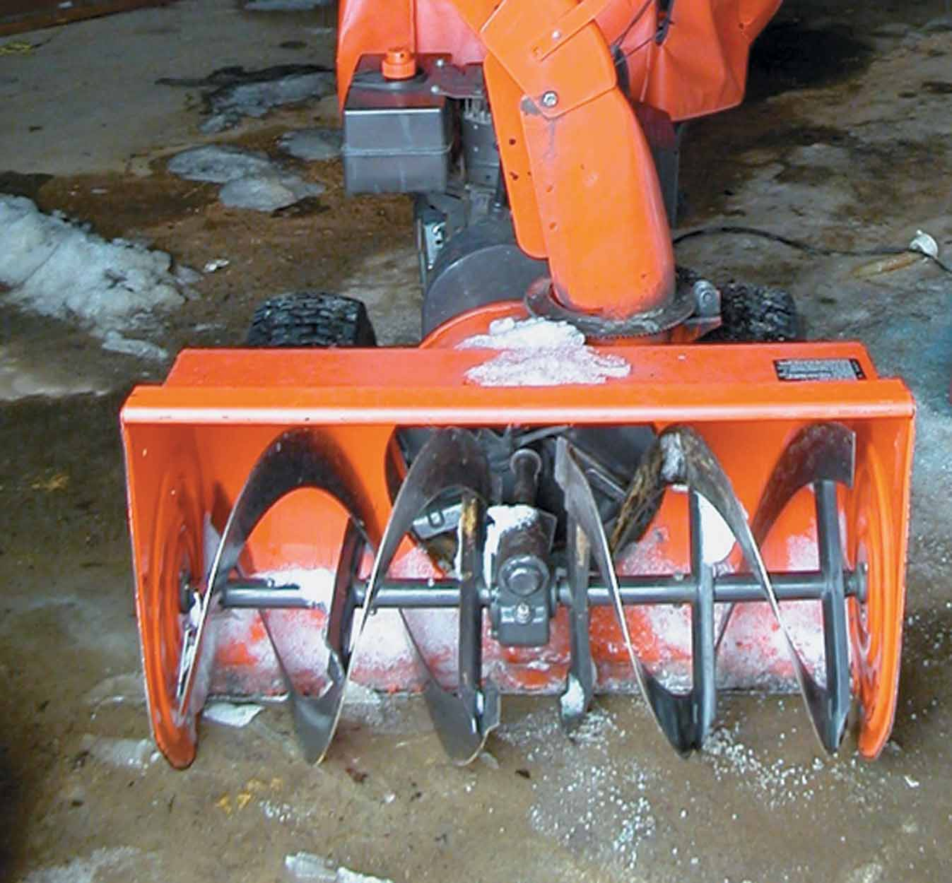
Figure 10.20 (continued) (d) Snow blower/auger system

Slide 14
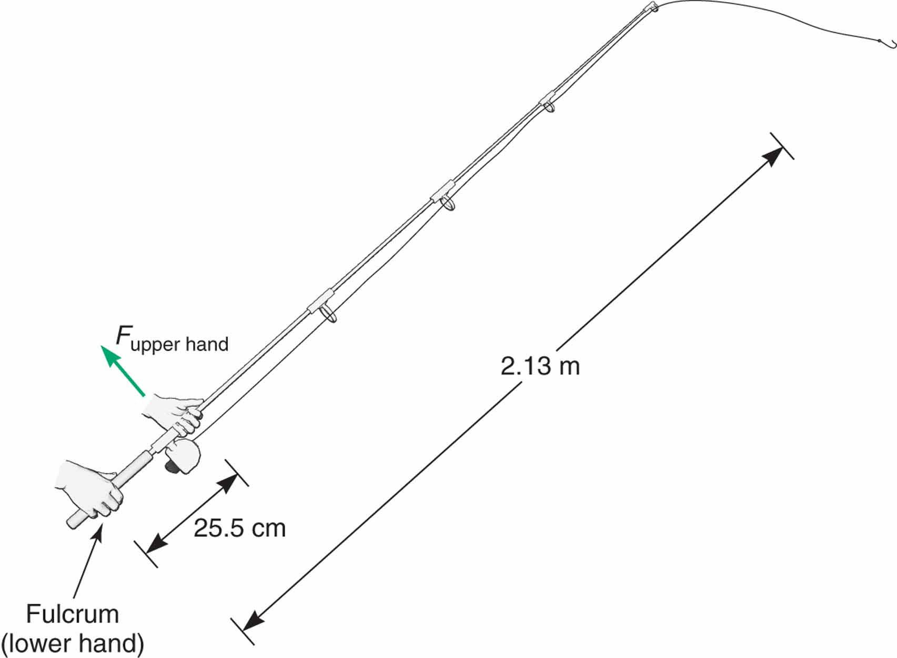
Figure 10.29

Slide 15
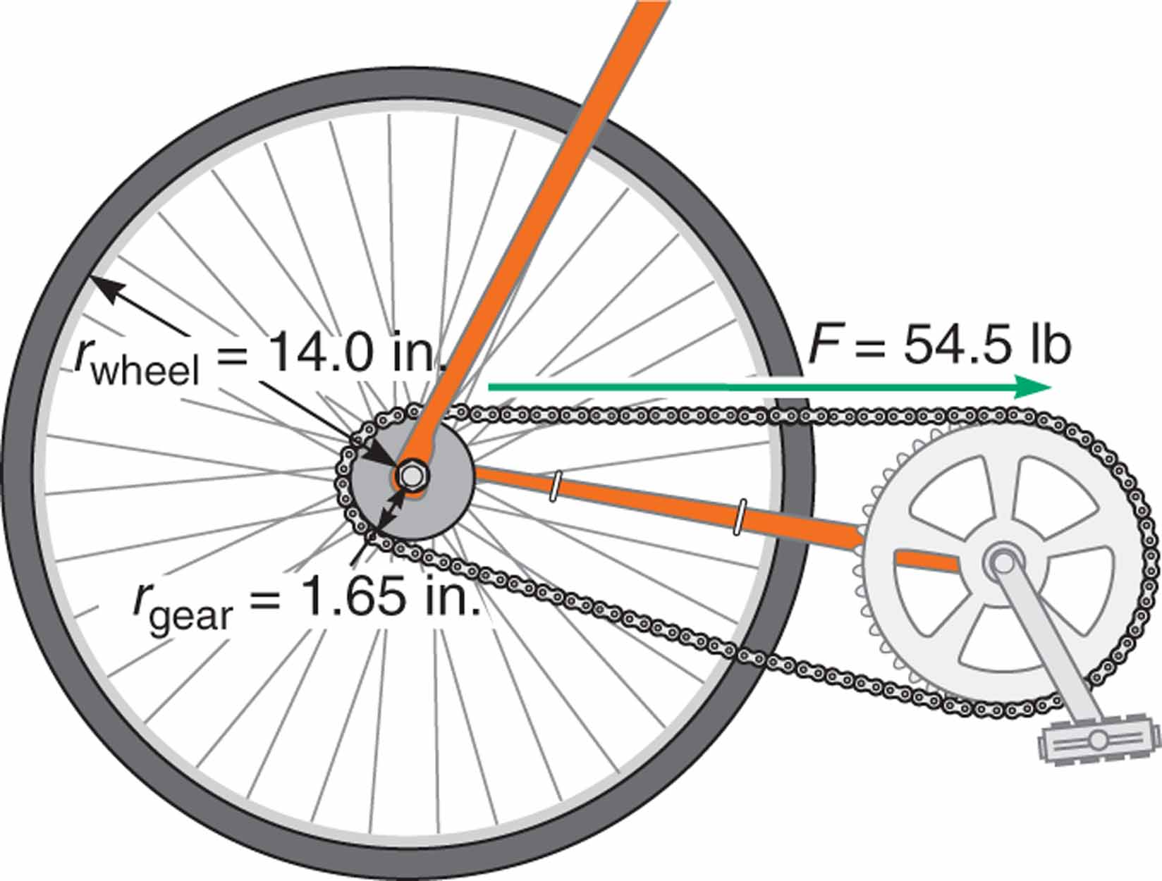
Figure 10.30

Slide 16
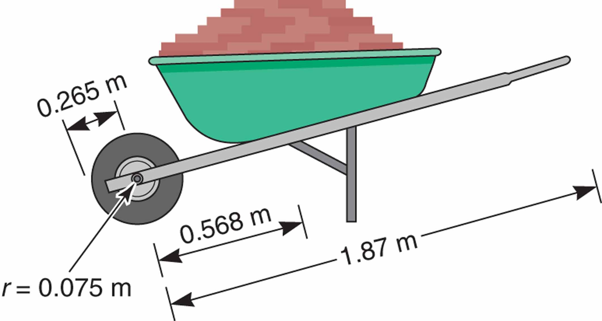
Figure 10.31

