Slide 1
Chapter 10
Simple Machines

Slide 2
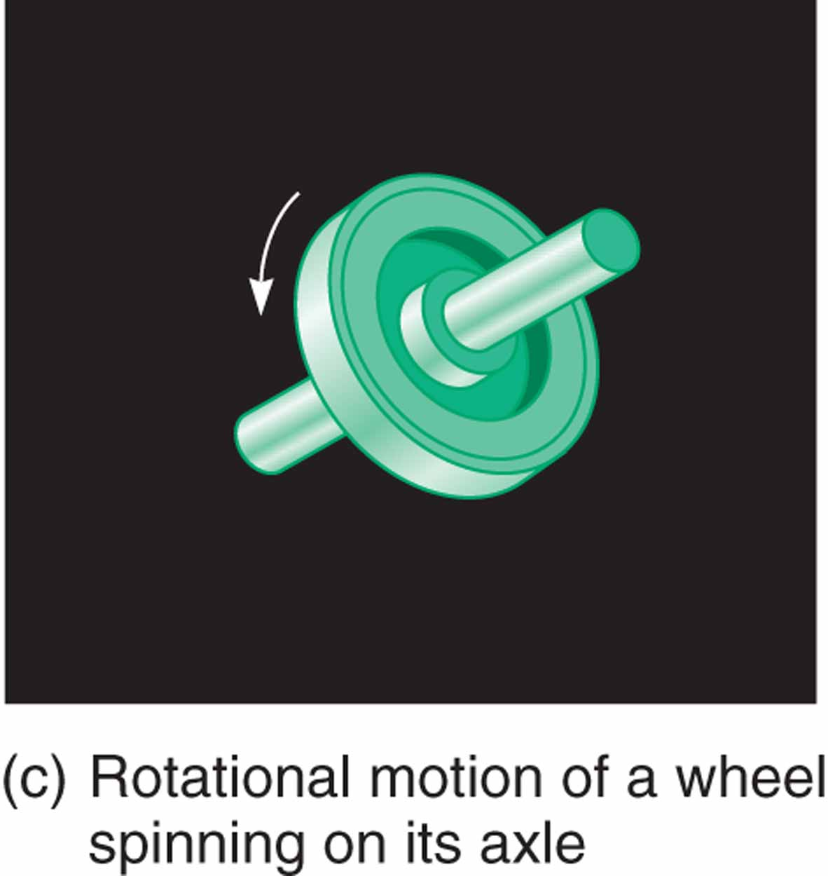
Figure 9.1 (continued)

Slide 3
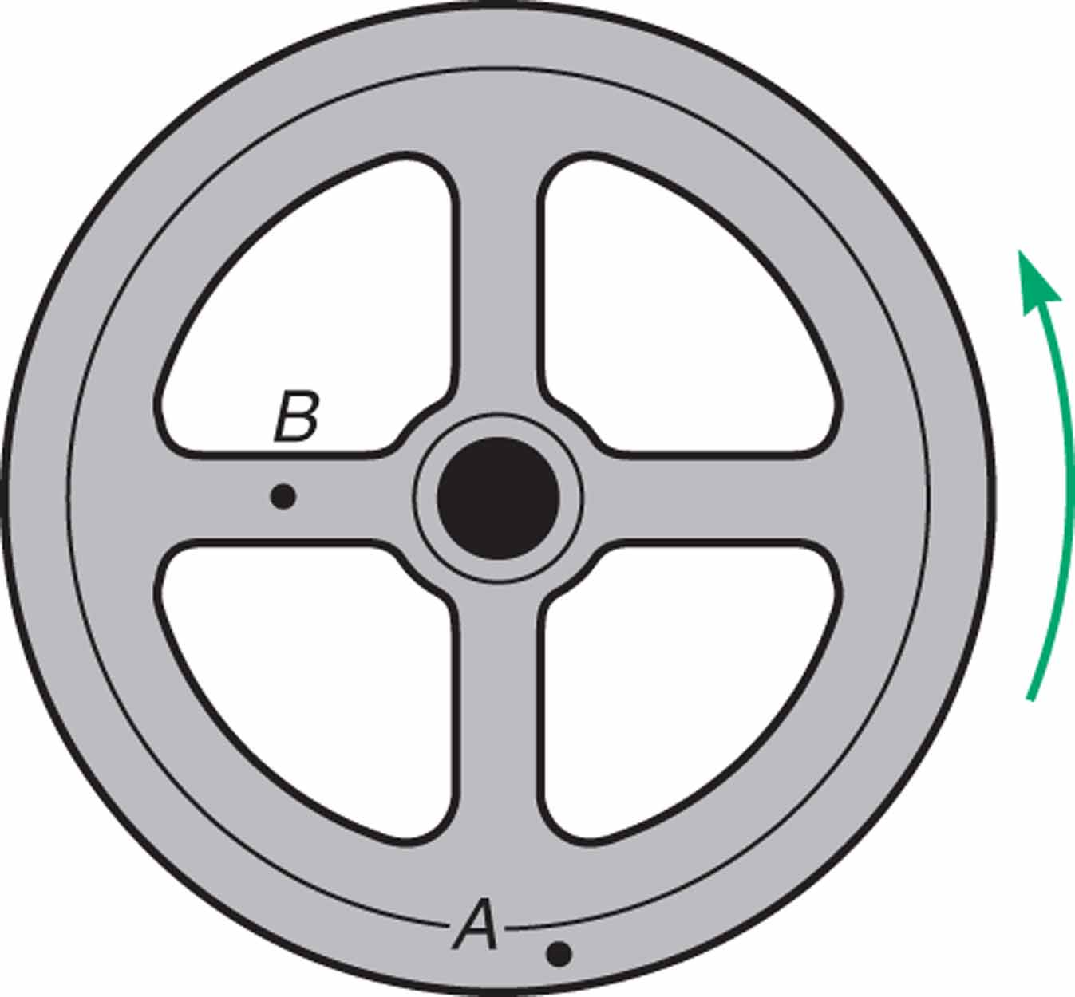
Figure 9.3 The angular displacements of points A and B on the flywheel are always the same.

Slide 4
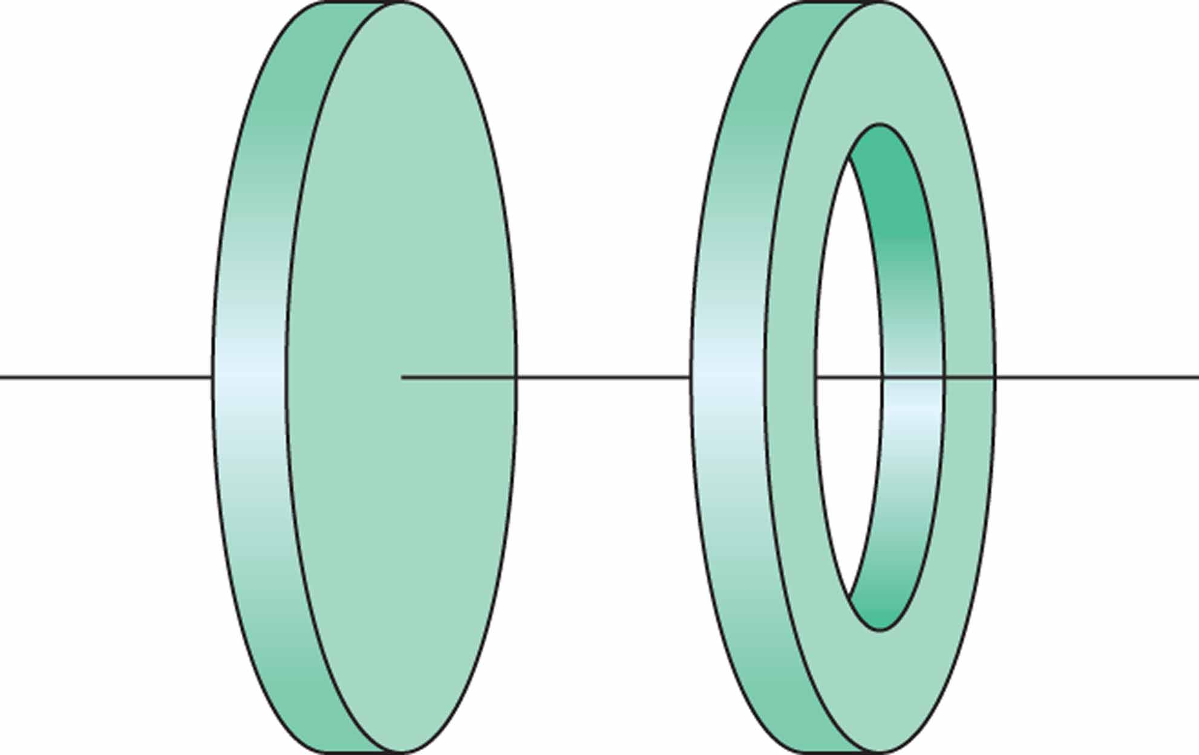
Figure 9.5 Even though the two cylinders are of equal mass, the hollow cylinder has more rotational inertia because its mass is concentrated farther from its axis of rotation.

Slide 5
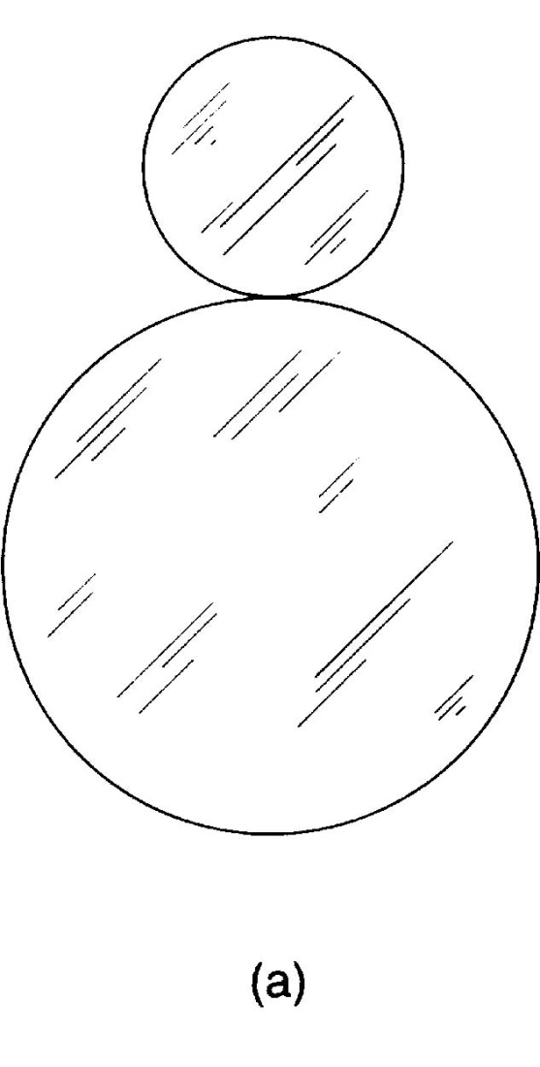
Figure 9.11 Gears and pulleys are used to reduce slippage in transferring rotational motion.

Slide 6
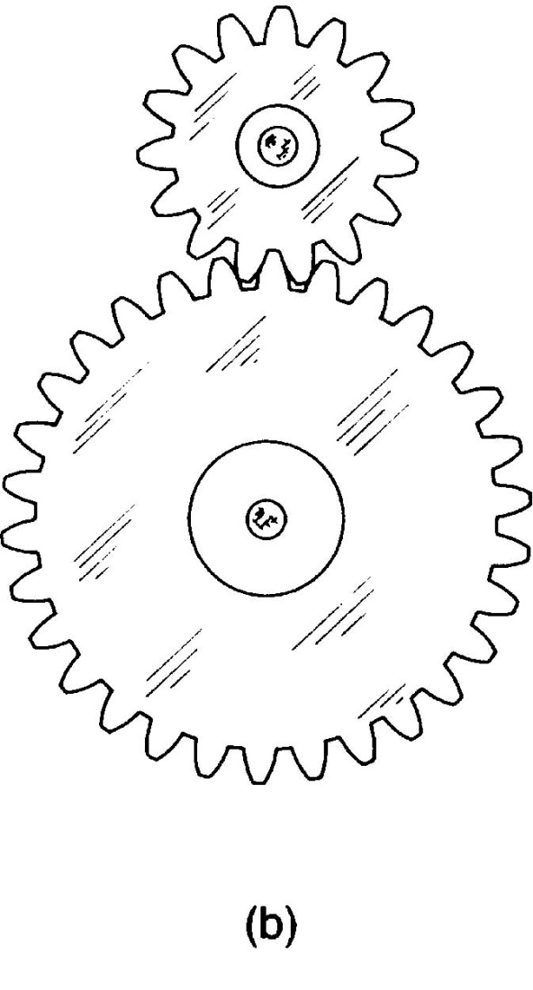
Figure 9.11 (continued) Gears and pulleys are used to reduce slippage in transferring rotational motion.

Slide 7
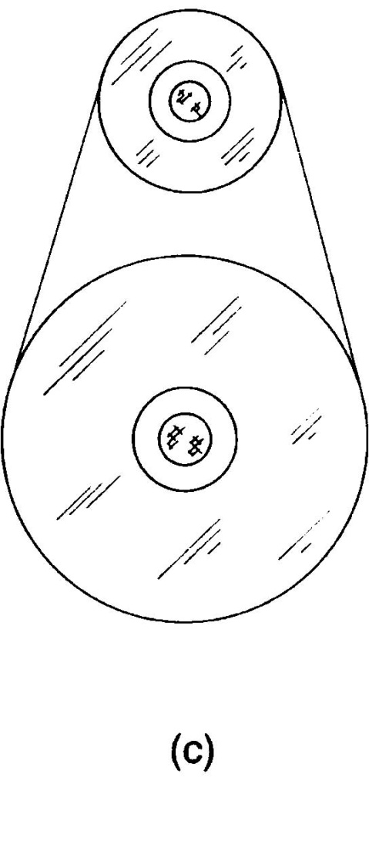
Figure 9.11 (continued) Gears and pulleys are used to reduce slippage in transferring rotational motion.

Slide 8
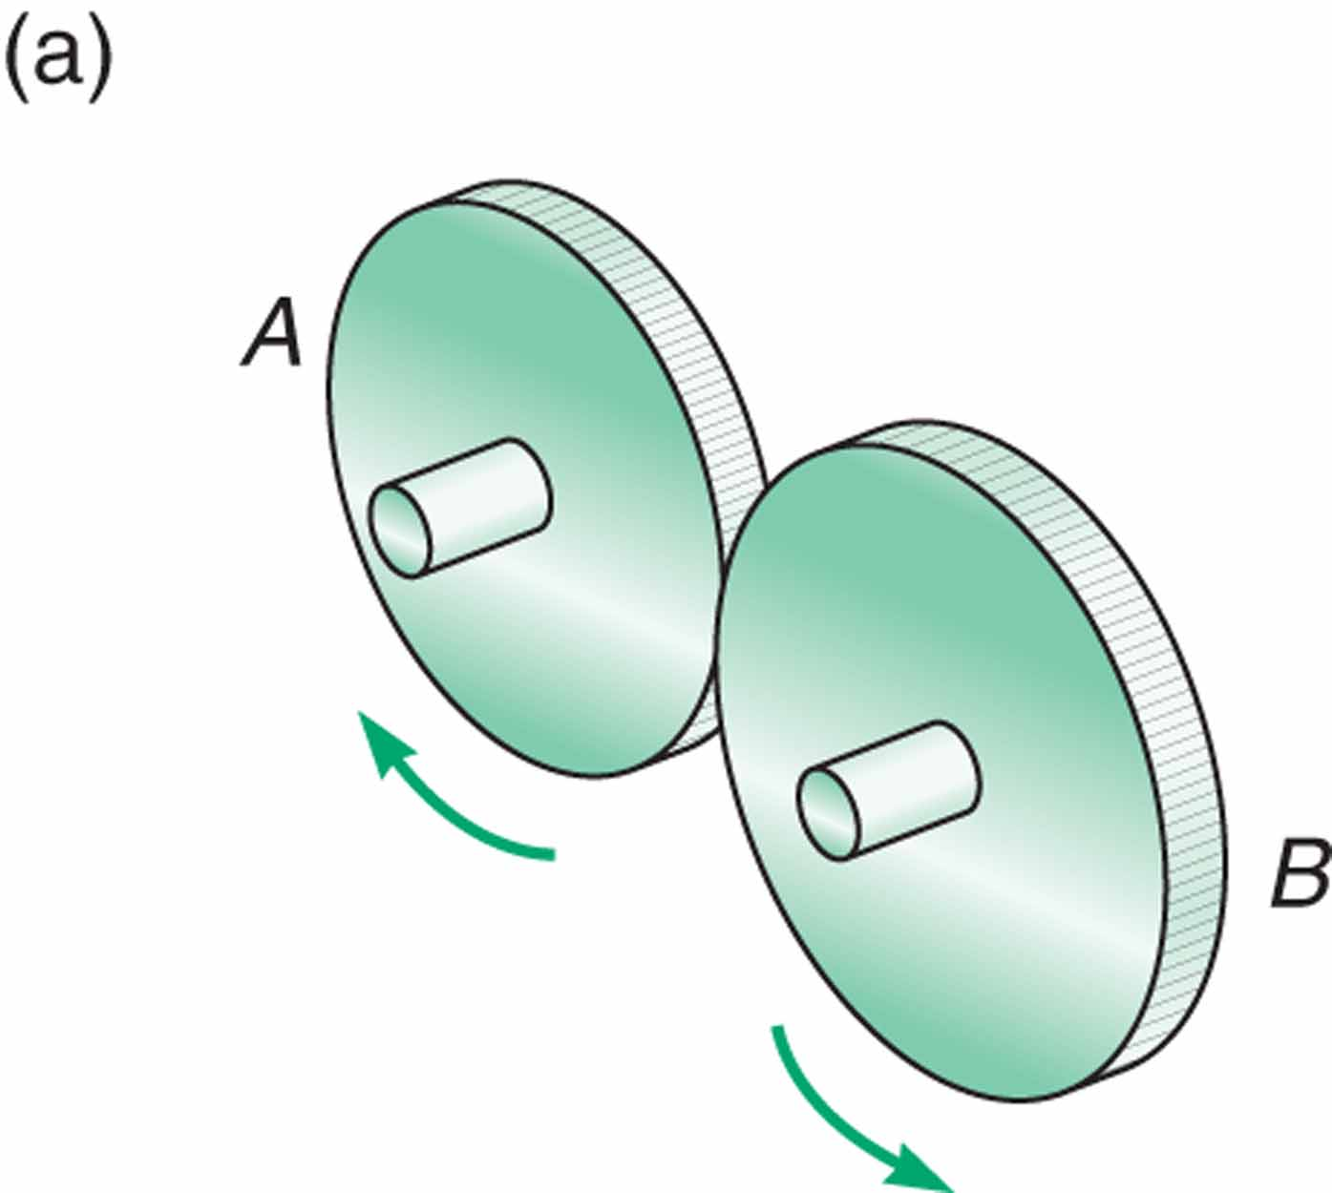
Figure 9.15

Slide 9
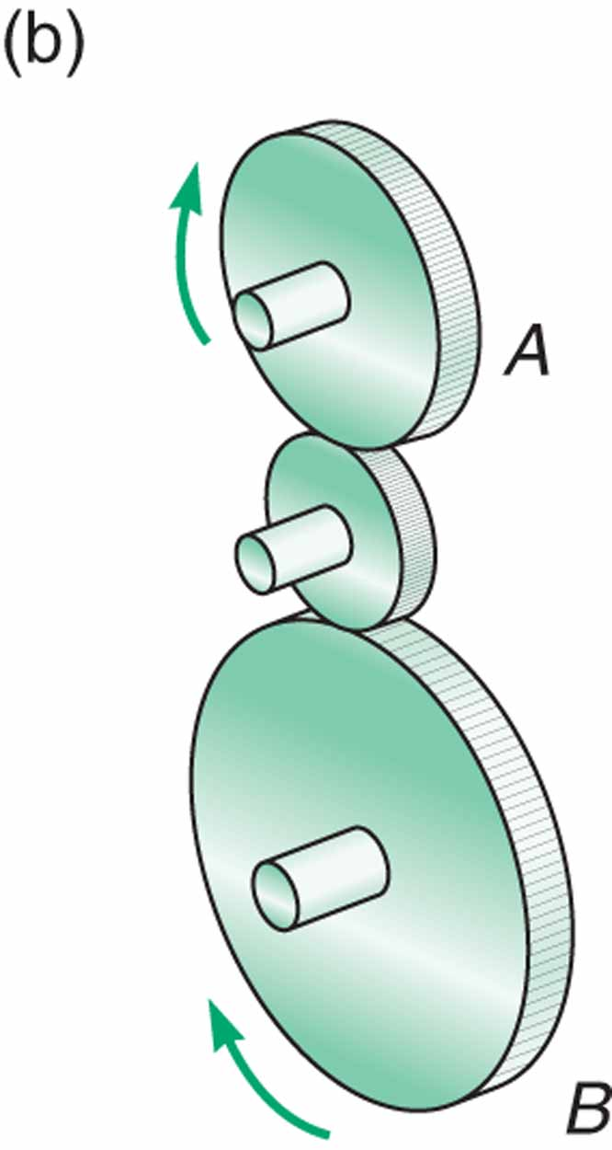
Figure 9.15 (continued)

Slide 10
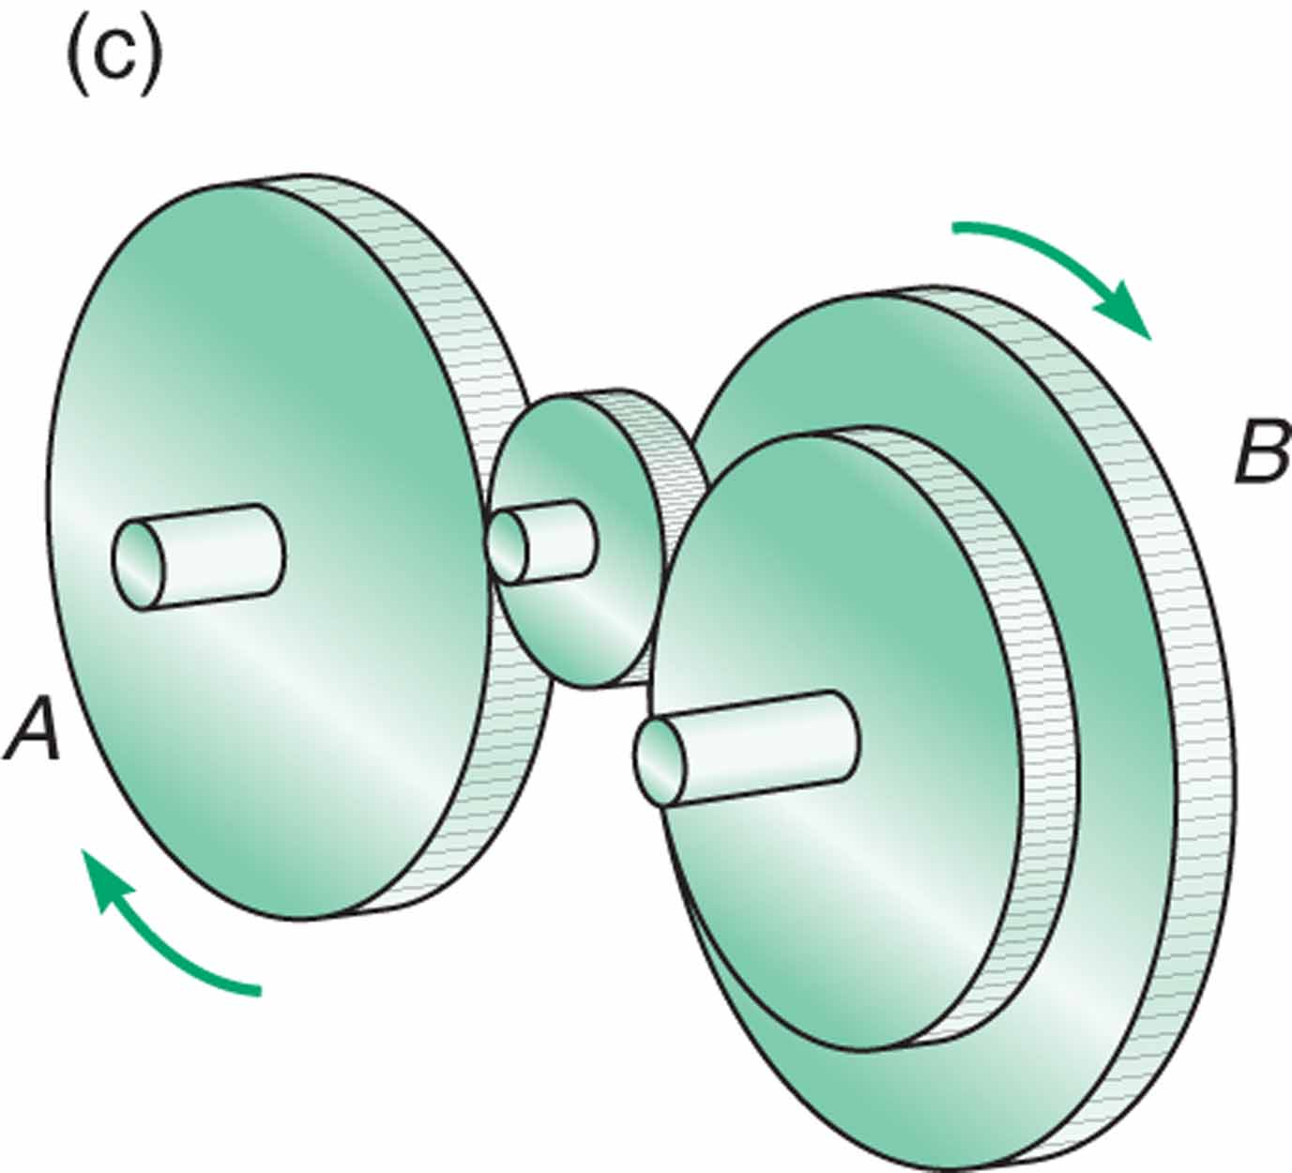
Figure 9.15 (continued)

Slide 11
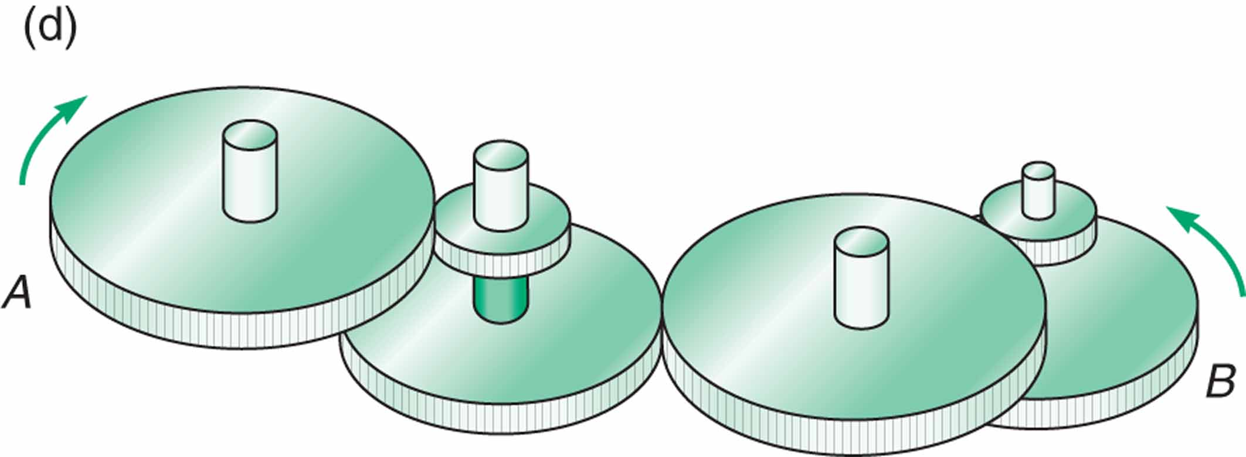
Figure 9.15 (continued)

Slide 12
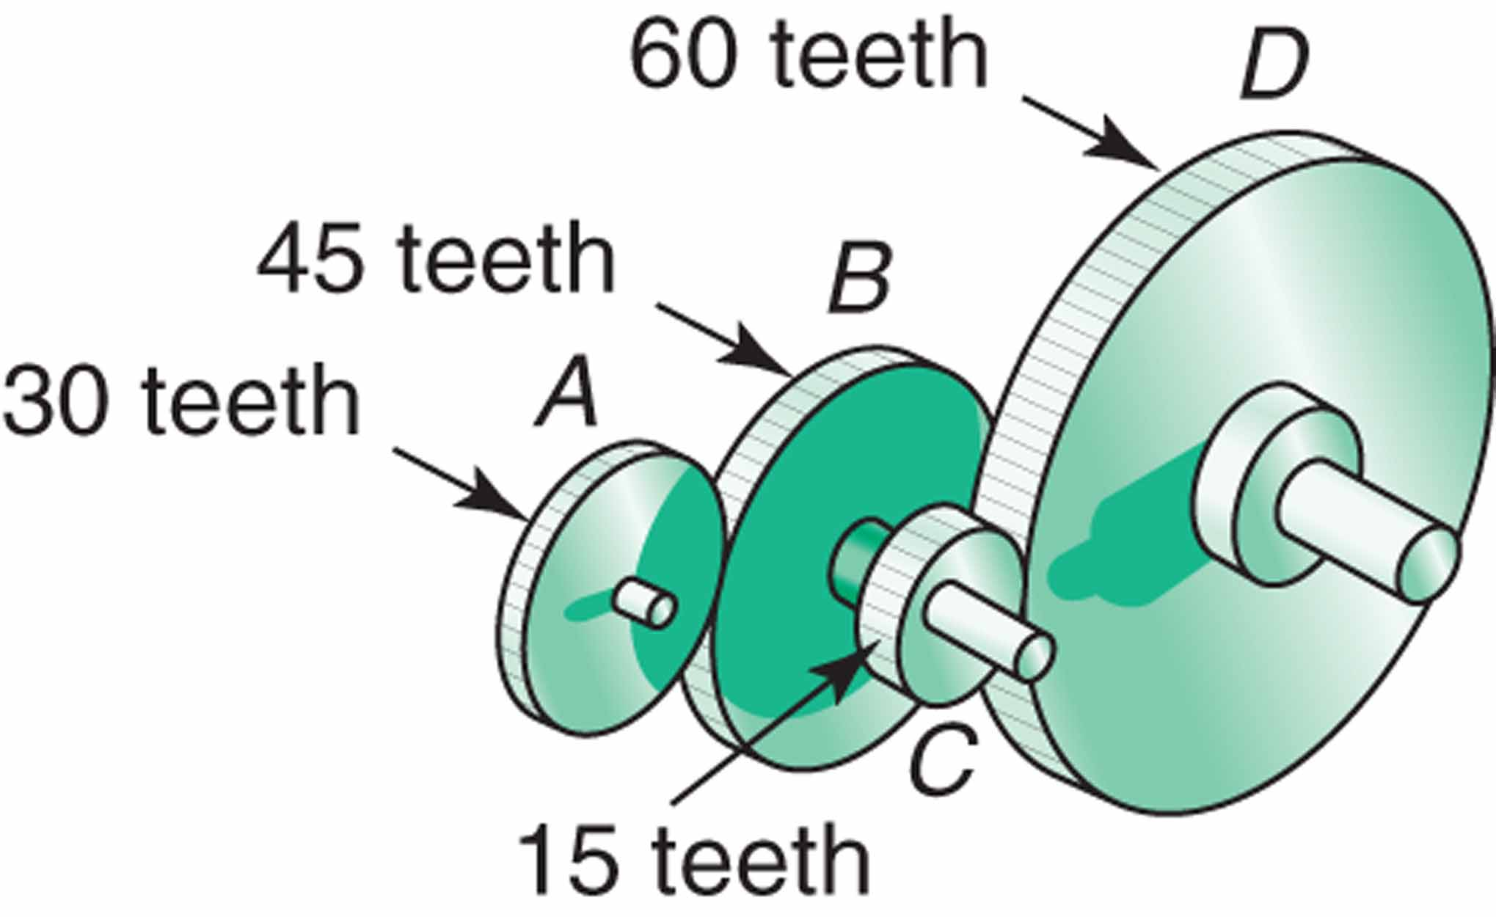
Figure 9.16

Slide 13
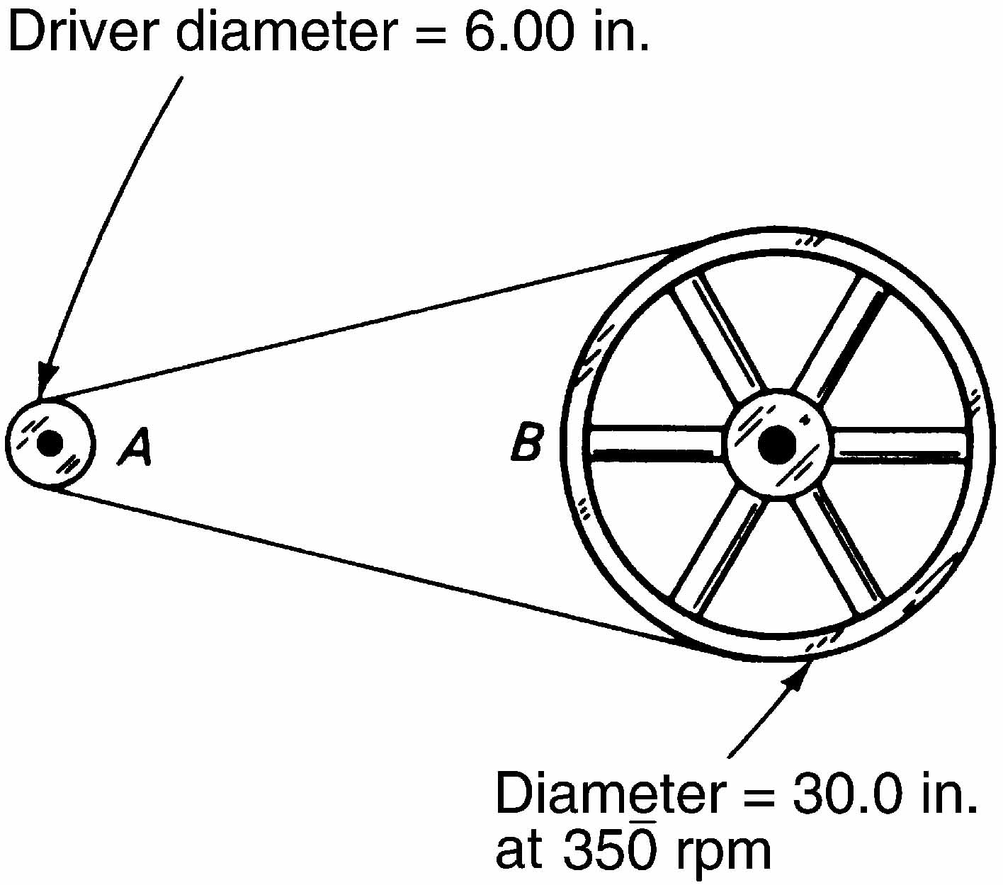
Figure 9.21

Slide 14
Figure 9.22 Crossing a belt reverses direction.

Slide 15
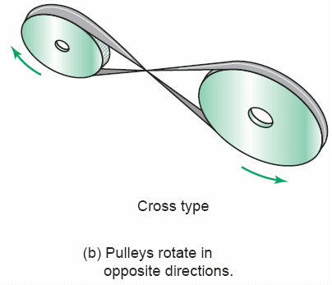
Figure 9.22 (continued) Crossing a belt reverses direction.

