Slide 1
Learning Resources
Ross university school of medicine
Office of Academic Analytics and Learning Management Systems
Tanner DeJean, Operations Analyst
Stephanie Cobelo, Solutions Analyst
Robert Byard, Director

Slide 2
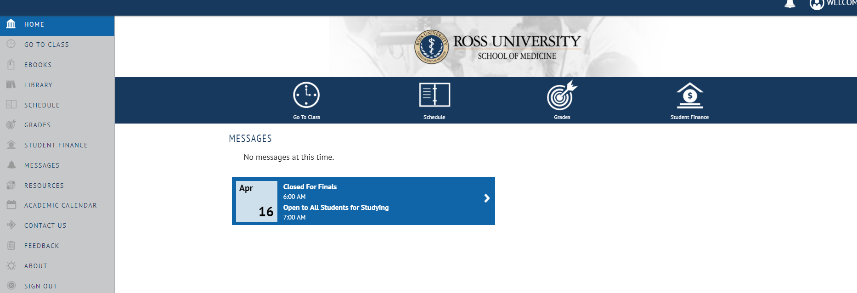
Mobile Application
https://my.rossmed.edu
Bookmark page for easy access
Log in using Network Username and Password
Click on Need Help? for resetting password issues

Slide 3
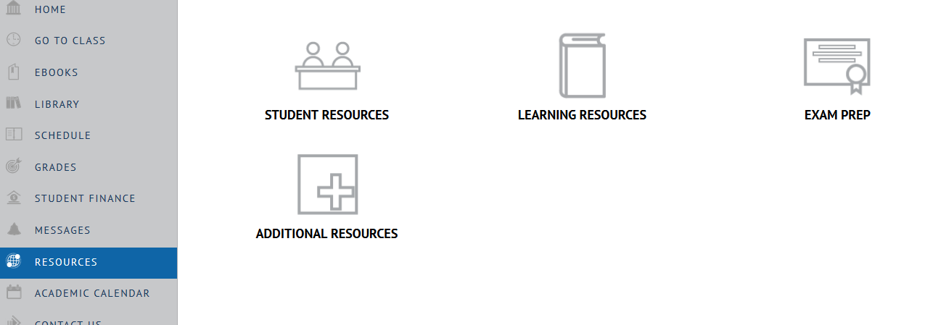
Resources
Resources takes you to all Learning Resources available
Student Resources = Office 365, the Portal (old), myRoss, Student Handbook
Learning Resources = list of all learning resources available
Exam Prep = Becker/UWorld information
Additional Resources = Merchandise, Siren, Bookstore

Slide 4
Go To Class: Canvas
Go To Class takes you directly to Canvas – LMS (Learning Management System) used to manage educational material for distributing online or blended/hybrid courses
All course materials, learning objectives, syllabus, etc. can be found here

Slide 5
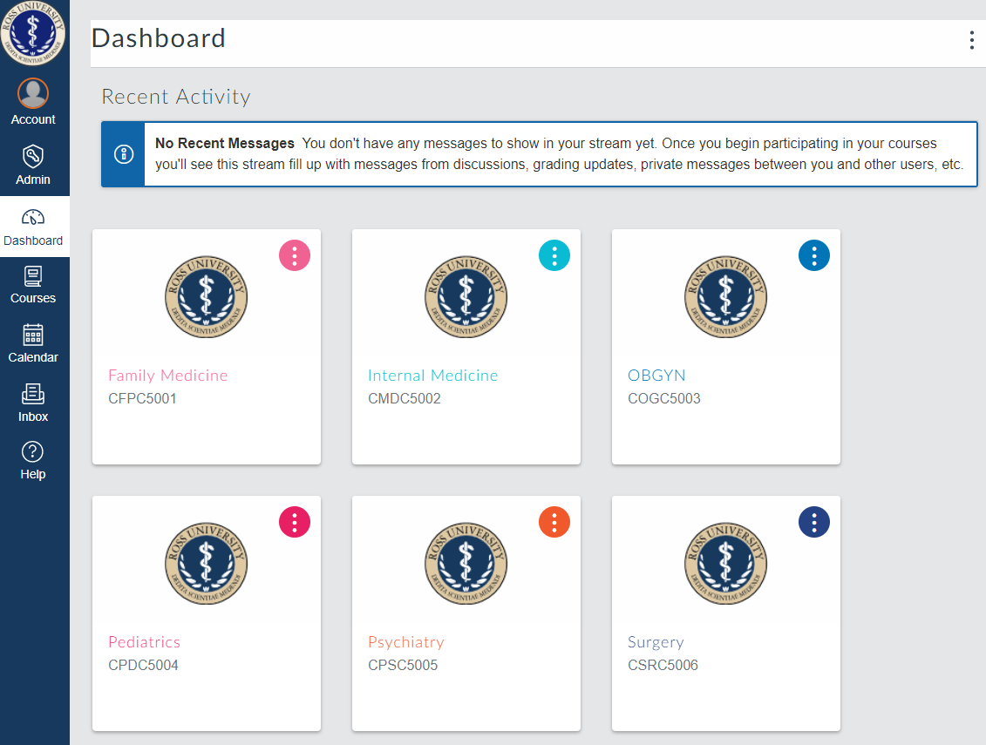
Go To Class: Canvas
Dashboard: shows what courses you are enrolled in
Can personalize course cards and change the name/color of different courses

Slide 6
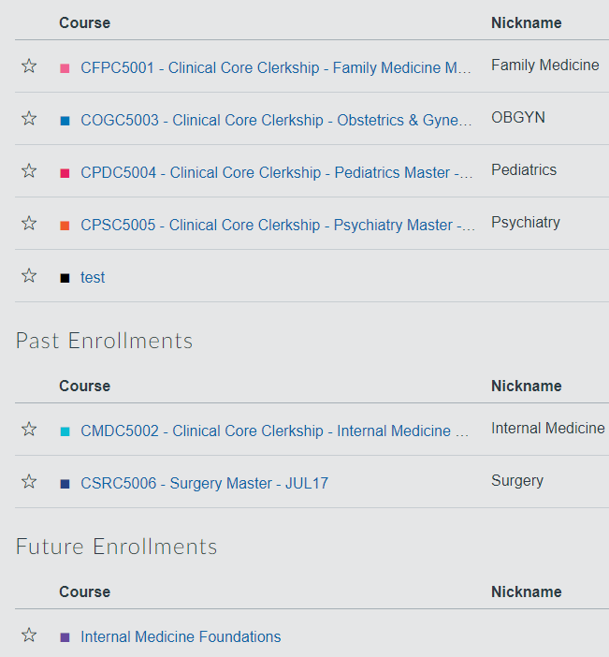
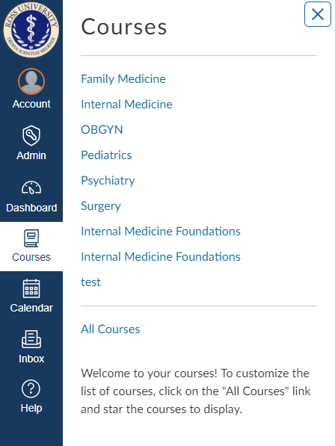
CANVAS
Courses
Shows all enrolled courses
Can easily switch from course to course
Courses
Use the star function to control what you see on the Dashboard
View expired courses

Slide 7
CANVAS
Account: Settings
Set up how to receive notifications
Account: Notifications
Set up what notifications to receive
How often to get notifications

Slide 8
Going Into A Course:
Dashboard: click on course card to enter course

Slide 9
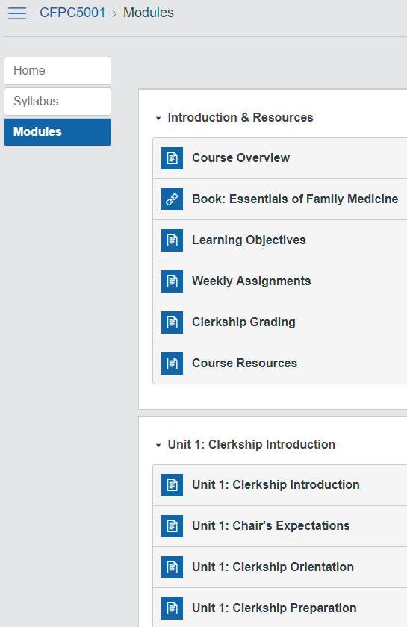
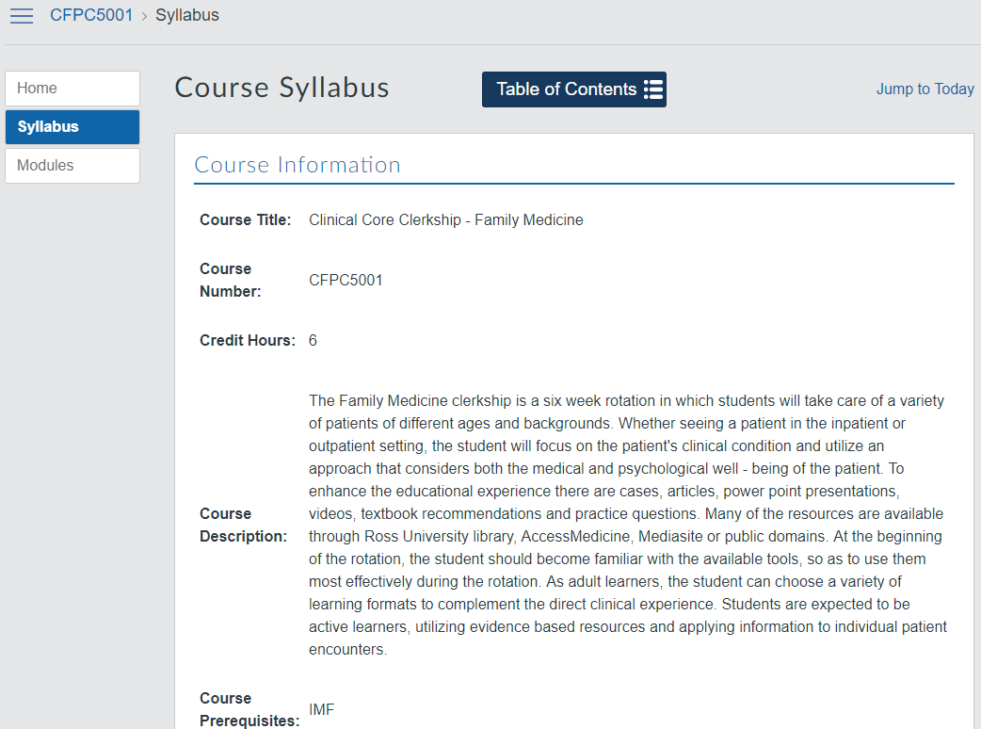
CANVAS
Syllabus
Overall course information found here
Modules
All course information housed here

Slide 10
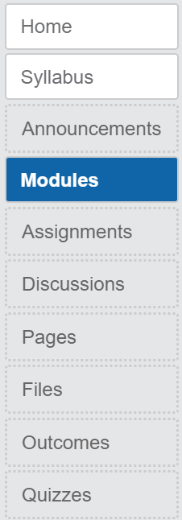
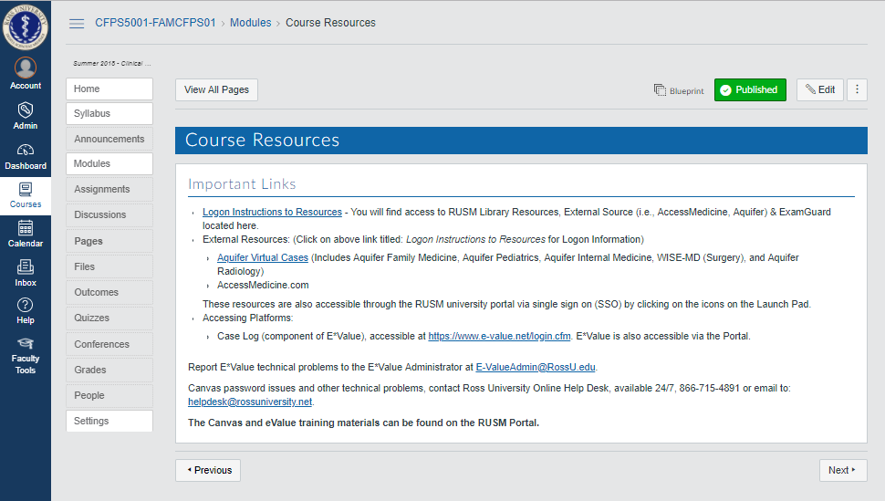
Canvas Resources
Electronic
Textbook
Clerkship Specific Electronic
Resources
Notes:
Electronic Textbook
Text
Resource
Weekly assignment
Introductory resources from Clinical Chair
All will be in Canvas

Slide 11
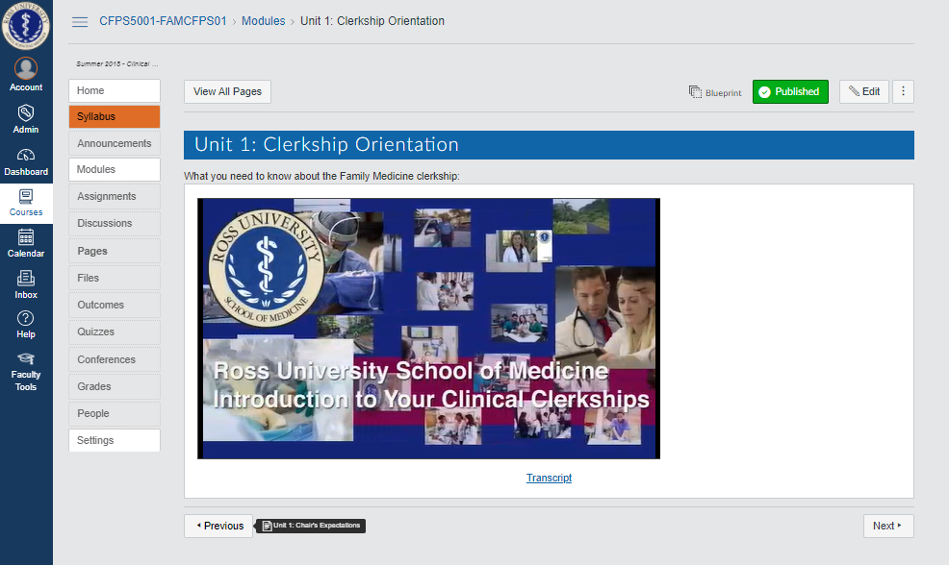
Canvas Resources
Weekly Assignments
Clerkship
Orientation

Slide 12
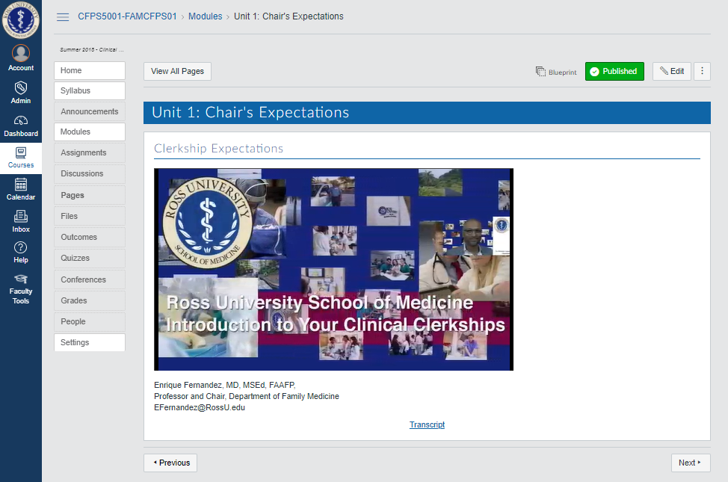
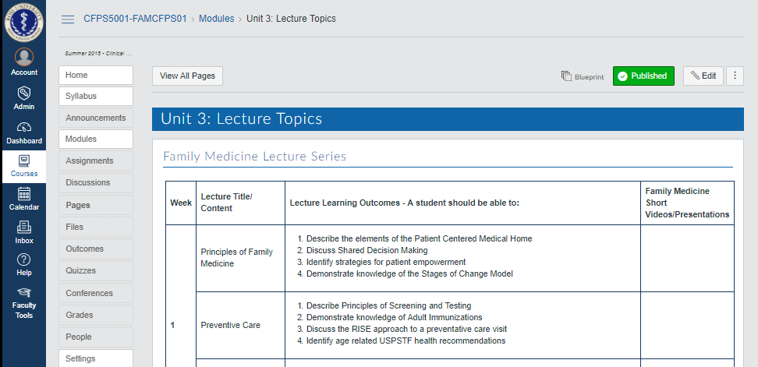
Canvas Resources
Chair’s Expectations
Lecture
Topics

Slide 13
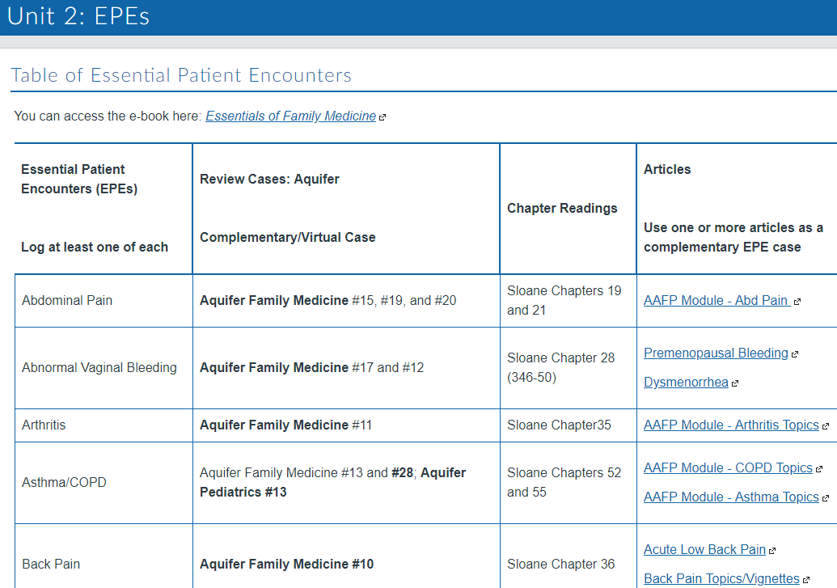
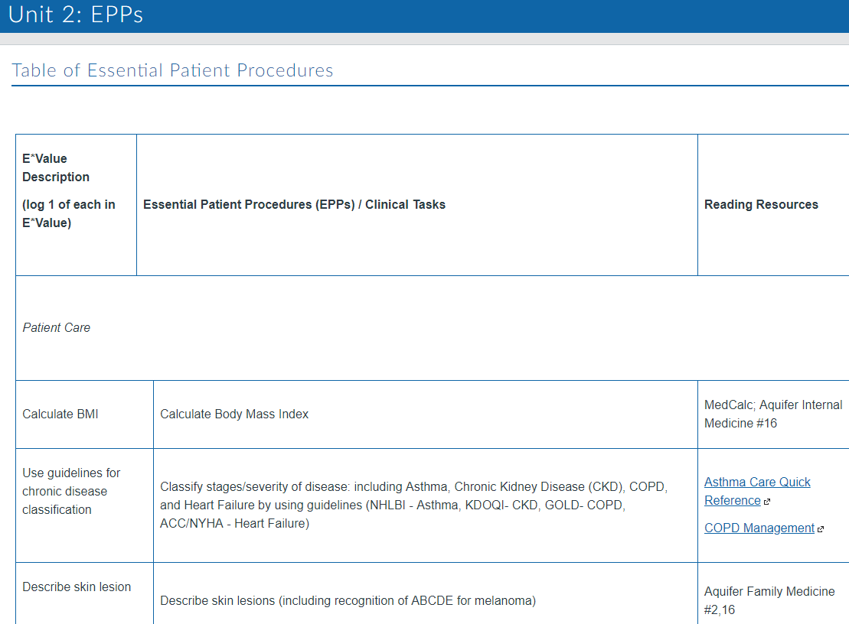
Course Information: Modules - VIP!
Essential Patient Encounters (EPE’s)
Essential
Patient Procedures (EPP’s)

Slide 14
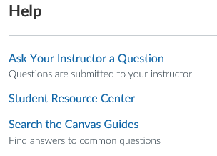
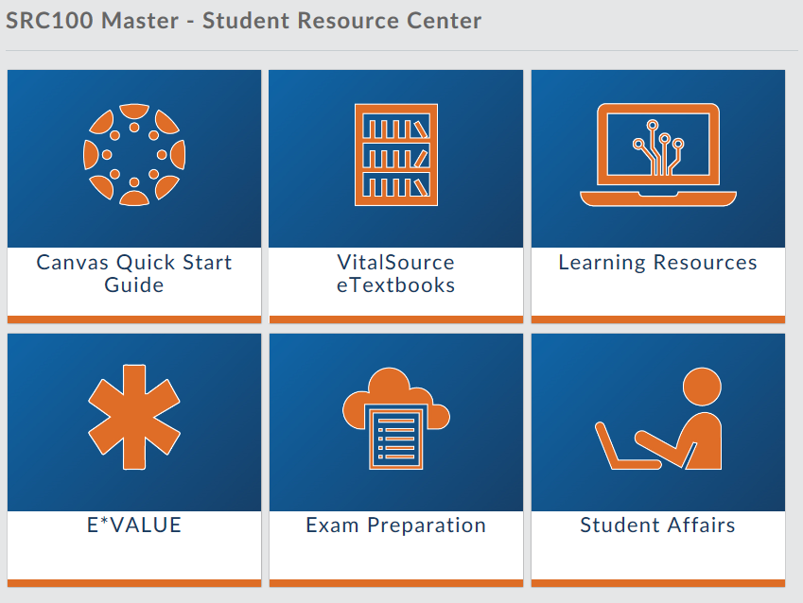
Help – Student Resource Center
Google Calendar Sync
Access Medicine
Aquifer
APGO
R2 Digital Library
NetAnatomy
Clinical Pharmacology
PubMed
Ovid
EBSCO

Slide 15
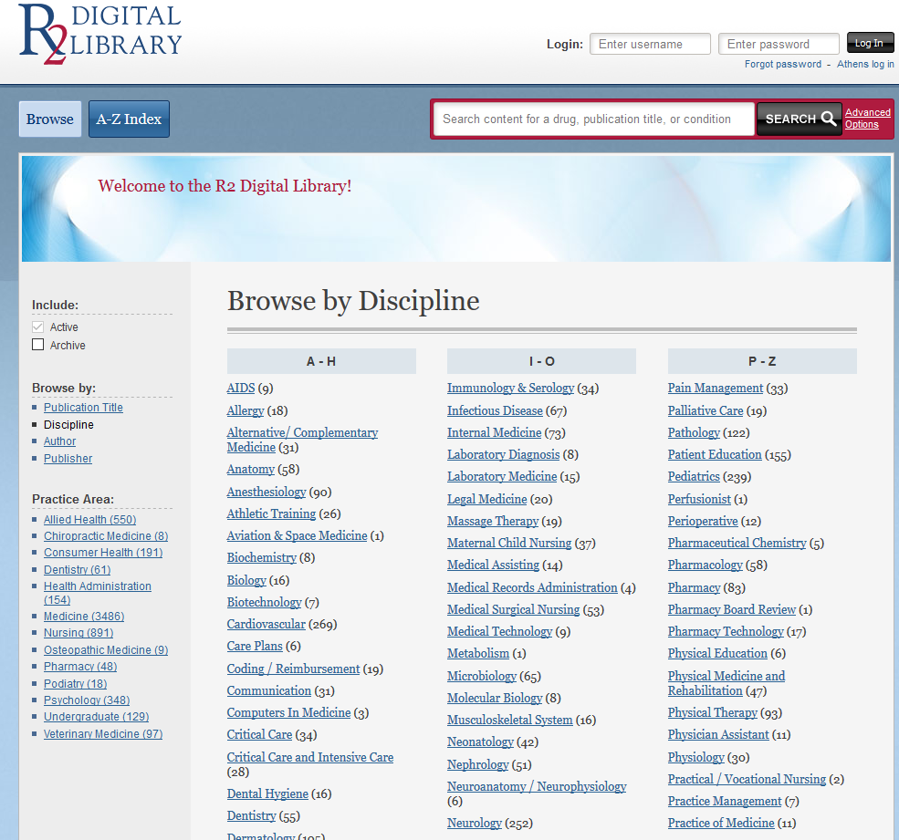
R2 Digital Library
Access to basic sciences and clinical sciences textbooks, including IM Essentials, Gray's Basic Anatomy, Robbins and Cotran Pathologic Basis of Disease, and Murray's Basic Medical Microbiology
Notes:
R2 Digital Library – (Useful)
Clinical Sciences Text Books, Gray’s Basic Anatomy, basics of diseases and Murray’s basic Medical Microbiology

Slide 16
NetAnatomy
Review of human anatomy after students begin clinical rotations, or as they prepare for the USMLE exams
Notes:
Net Anatomy - (effective)
Prepare for Step 2 CS and CK exams

Slide 17
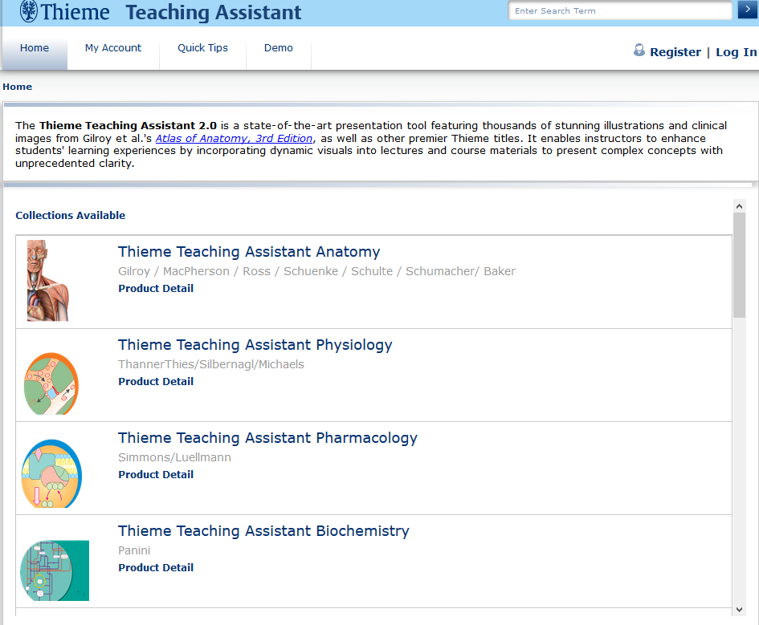
Thieme Teaching Assistant
A state-of-the-art presentation tool featuring thousands of illustrations and clinical images from Gilroy's Atlas of Anatomy
Notes:
Thieme – (hands-on)
Presentation Tool
Gilroy Atlas of Anatomy
Student Portal

Slide 18
Biomedical & Life Sciences
A regularly updated collection of specially prepared animated audio visual presentations on basic science topics with synchronized narration
Notes:
Biomedical and life sciences
Another presentation Tool that has basic science topics – Review

Slide 19
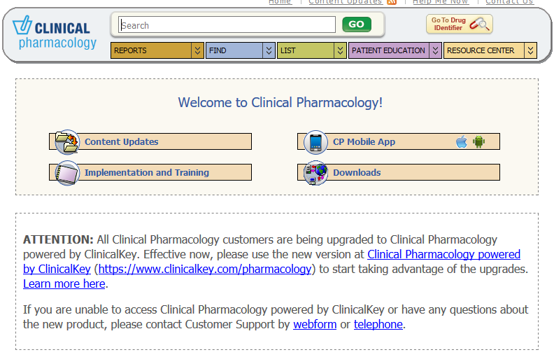
Clinical Pharmacology
A point-of-care drug reference solution that provides comprehensive current drug information
Notes:
Clinical Pharmacology – (repository)
SSO
You can enter any drugs and gives you the interactions
How one drug counter the other – refresher for what you studied in Pharmacology on the island

Slide 20
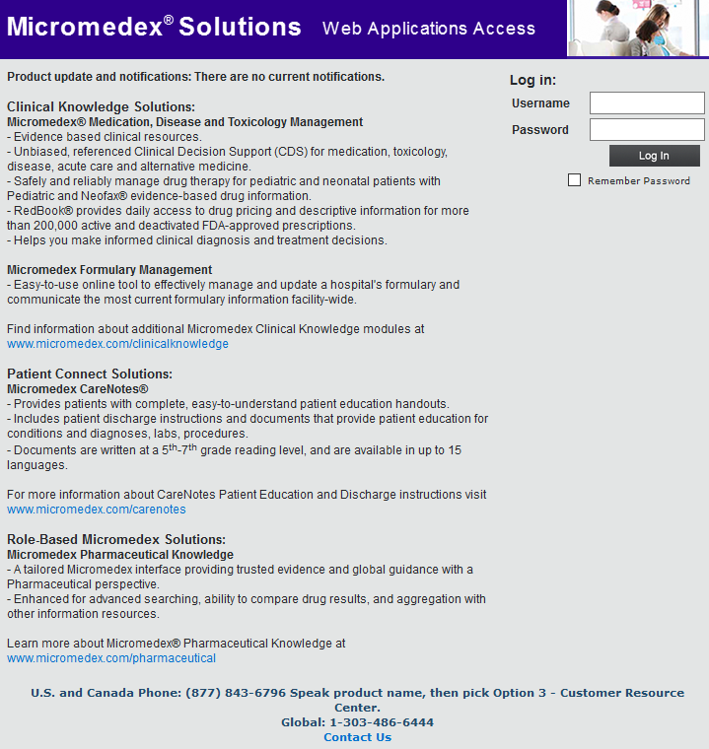
Micromedex
Supports clinical medication and therapy decisions, quality improvement and patient education
Notes:
Micromedex
Clinical medication and therapy decisions, quality improvement and patient education

Slide 21
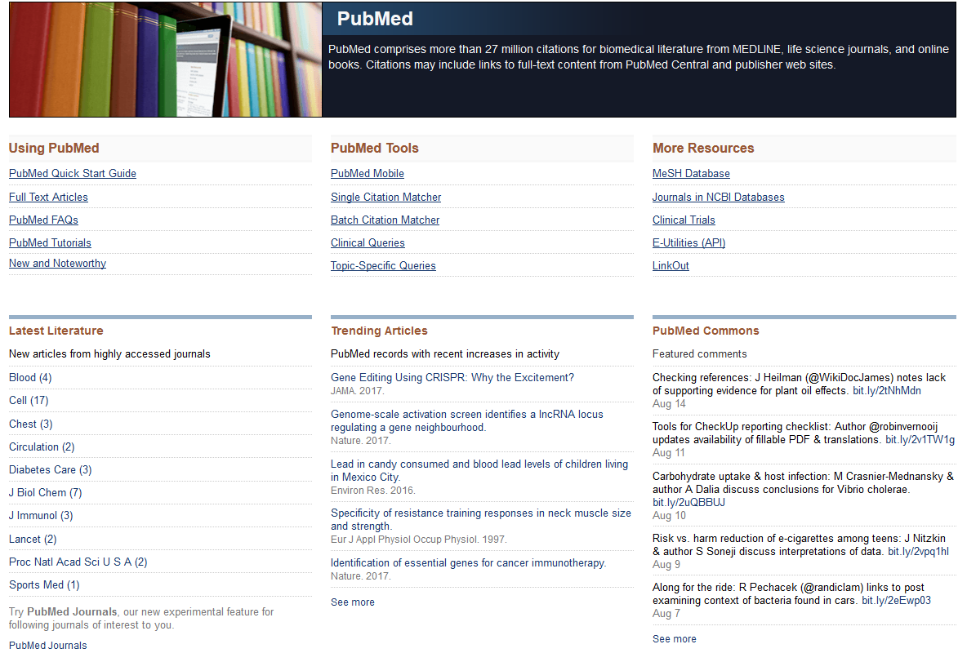
PubMed
Index of more than 27 million citations for biomedical literature from MEDLINE, life science journals, and online books
Notes:
Pub Med
Biomedical literature
Medline, Life Science Journals and Online books

Slide 22
Science Online
Science Magazine articles and research papers from 1997 to the current issue
Notes:
Science Online
Magazine - Research papers – available through the portal

Slide 23
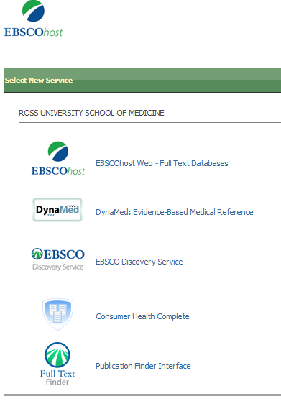
EBSCOhost Database & Electronic Journals
EBSCOhost Database - access to MEDLINE, DynaMed, Gideon, Consumer Health, Psychology/Behavioral Sciences Collection, Cochrane Collection through common interface
EBSCOhost Electronic Journals - access to Annual Reviews and other journals
Notes:
Ebscohost database
Medline, DynaMed, Gideon

Slide 24
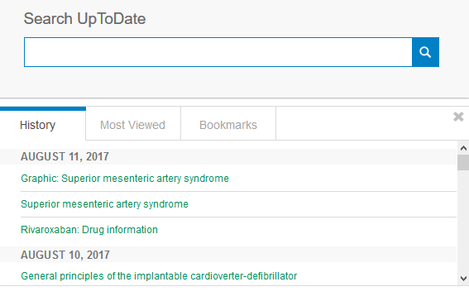
UpToDate
An evidence-based, physician-authored clinical decision support resource which clinicians trust to make the right point-of-care decisions
Notes:
UpToDate
Really useful resource
Clinical decision support and point of care
SSO via Mobile and Canvas

Slide 25
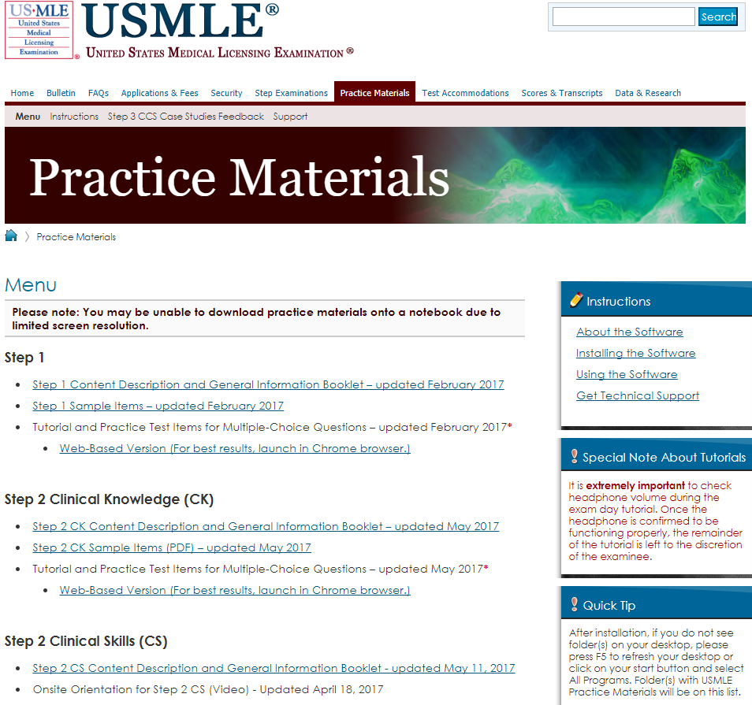
USMLE Resource
USMLE Website - http://www.usmle.org/practice-materials/index.html
Free resource for Step 1 and Step 2 CS/CK materials, including practice exams and question banks
Notes:
USMLE Website
Free resources
STEP ½
Question banks and articles
Free Materials

Slide 26
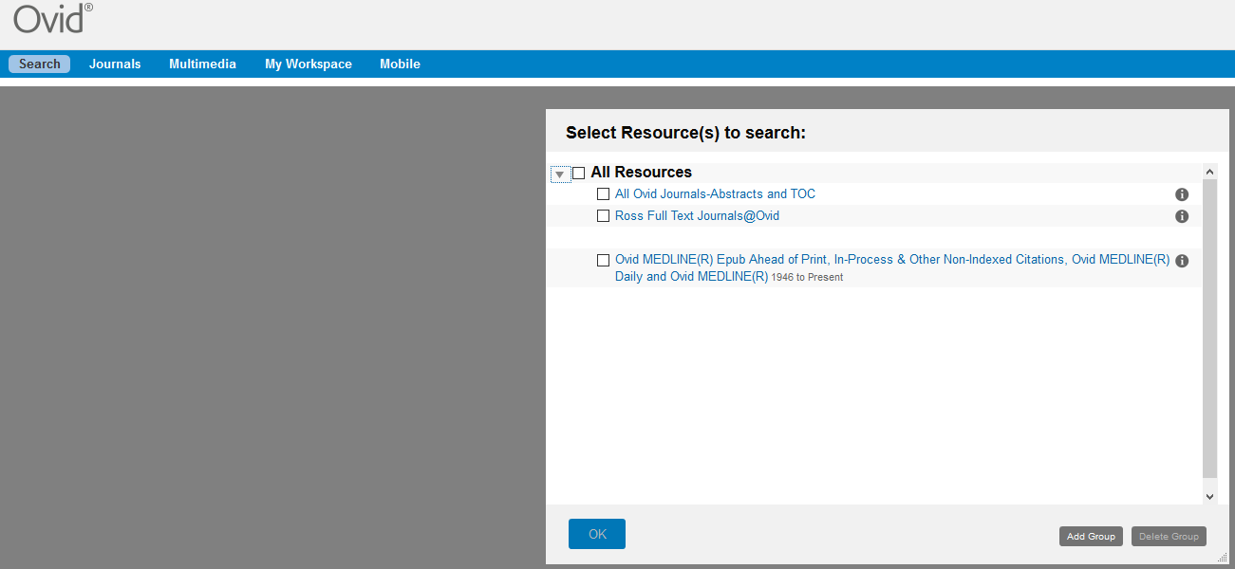
Ovid
Online journal and multimedia resource with access to Nature, Academic Medicine, New England Journal of Medicine and other journals
Notes:
Ovid
SSO via Mobile app and Canvas
Comprises of articles found in the England Journal Medicine

Slide 27
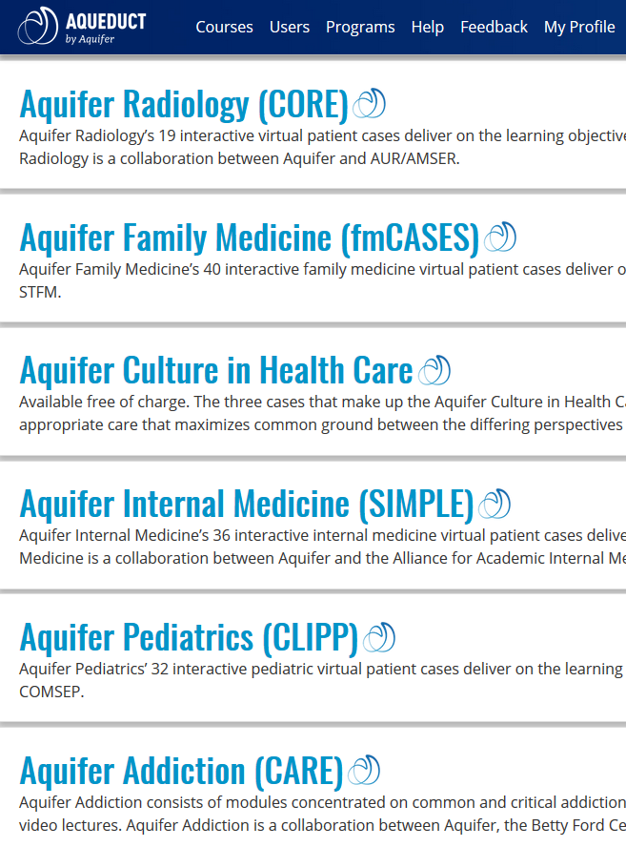
Aquifer
Must use RUSM email to access system
Email LMS@RossU.Edu for issues
Includes Aquifer Family Medicine, Aquifer Pediatrics, Aquifer Internal Medicine, Wise-MD Surgery, and Aquifer Radiology
Notes:
Medu/Aquifer
Resource access to all the cases
Complimentary cases
Login with email address and do reset password
No SSO
Transfers would have to let us know so they can be added to the system

Slide 28
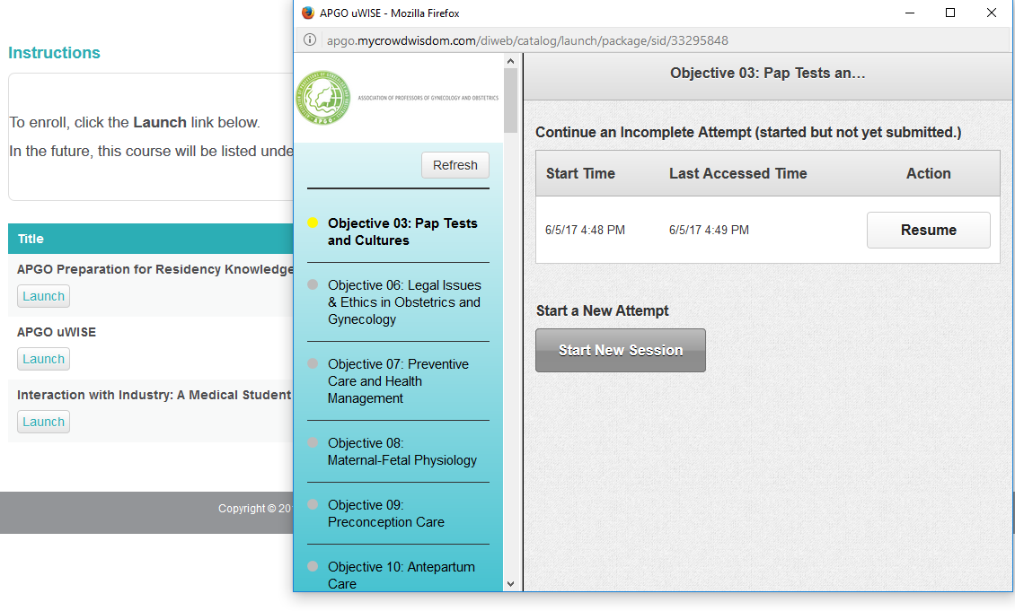
APGO uWise
ObGyn Specific Resource
Students can register and create a log-in using RUSM email
Used for practice question banks found in Weekly Assignments
Notes:
APGO UWISE ObGyn Specific resources
Click Register and Login with your RUSM Email
Weekly OB-GYN assignments

Slide 29
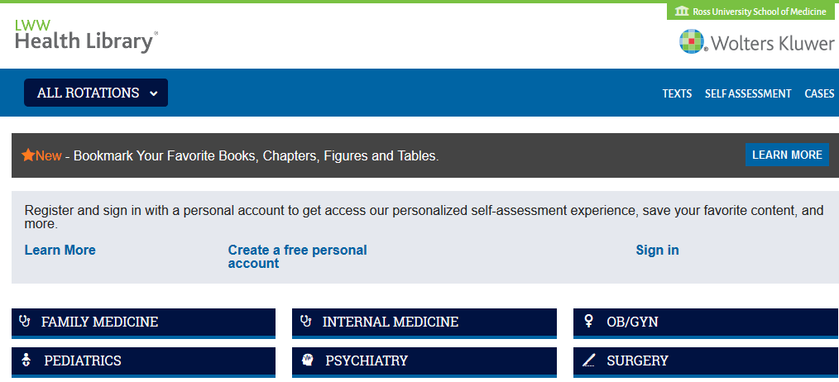
Health Library
Access to digital version of student textbooks and chapter question banks
Notes:
Health Library
Latest resource Access to textbooks and question banks through the library resource page
Will be in Canvas resource course
Self Assessment
Question banks

Slide 30
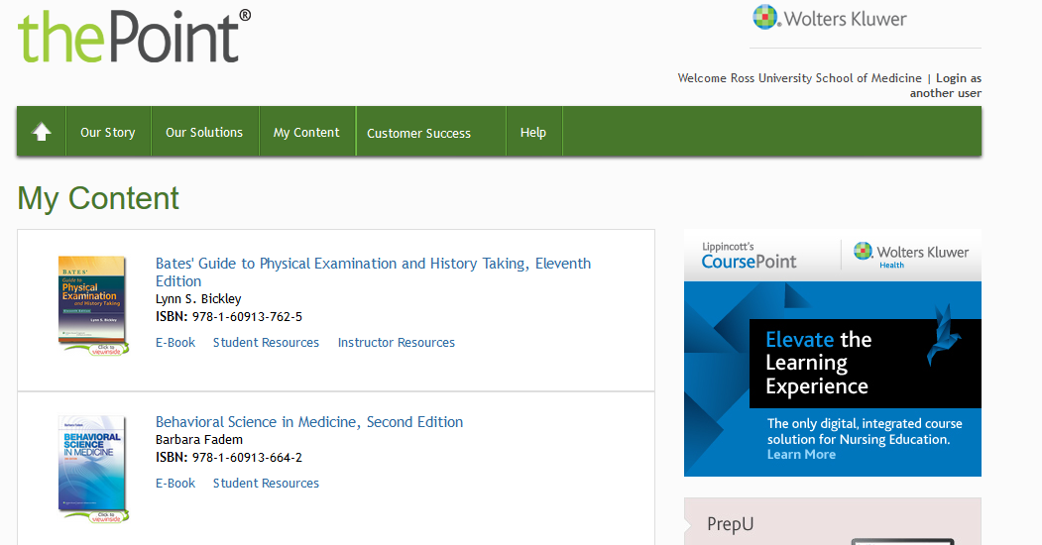
ThePoint
Access to digital version of student textbooks, including Bates’ Guide to Physical Examination and History Taking, Behavioral Science in Medicine, and Clinically Oriented Anatomy
Question banks for chapters in your textbooks
Notes:
The Point
Latest resource Access to textbooks and question banks
Available in the Canvas Student Resource Course
Will be in Canvas resource course

Slide 31
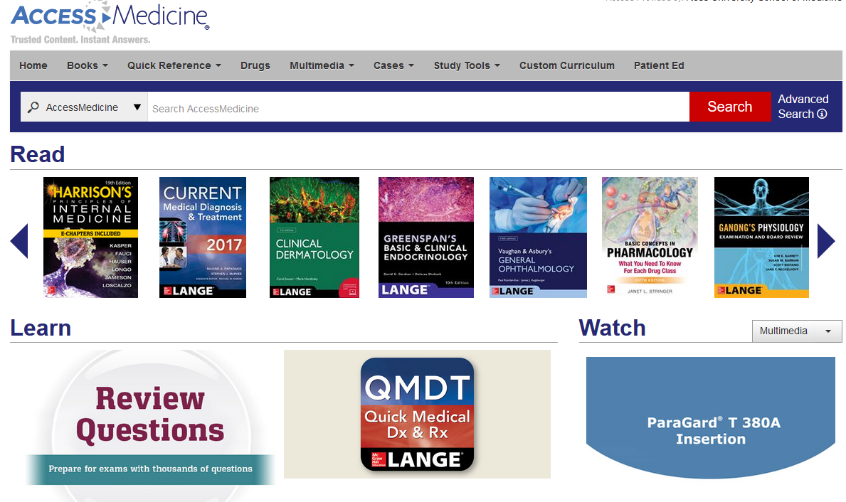
Access Medicine
An online resource with more than 75 medical titles, updated content, thousands of images and illustrations, interactive self-assessment, case files, time-saving diagnostic and point-of-care tools
Notes:
Access medicine
Case files, Self-assessment, point of care tools
When you are in your cores There are certain complimentary cases for EPPs and EPEs you can get those in access medicine through the Launchpad

Slide 32
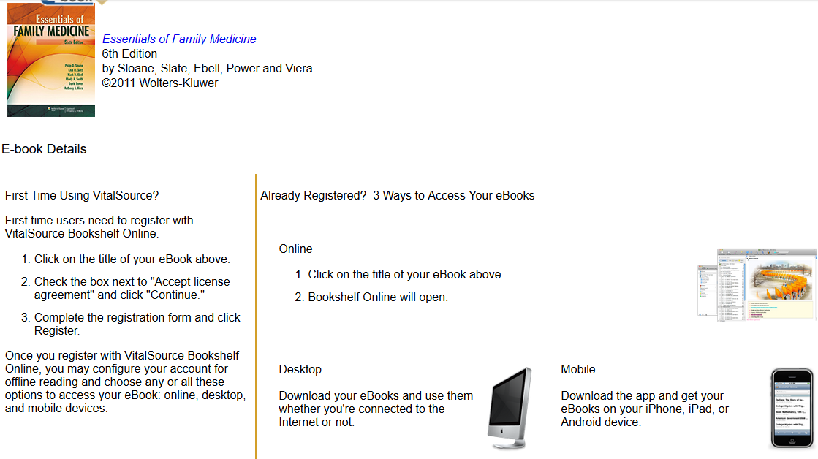
VitalSource
E-book reader-resource with student access via online, desktop, and mobile
Students must register with Bookshelf (download app as well) in order to access e-books offline
Able to take notes and highlight in the text, and share notes with other students
Notes:
Vital Source
Mobile app – Resources - under additional resources – bookstore and then you will be able to purchase
Resource for your online eBook resources, notes practice question, highlights with other students- you have these books forever
Go through Ambassador and make payments

Slide 33
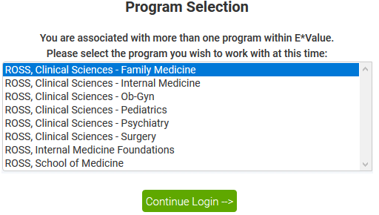
E*Value
E*Value - accelerates RUSM curriculum planning, course work, optimized scheduling, assessments, and site management
Students can log patients/simulated patient encounters here, as well as complete core evaluations, and keep track of completion of EPE’s and EPP’s
Notes:
eValue
SOO is on going
Log EPP, EPE, evaluations - (Mid, End and faculty)
EPE’s and EPPs is in Canvas Tutorial

Slide 34
Questions?
For additional information, contact the Office of Academic Analytics and Learning Management Systems:
LMS@RossU.Edu
754-707-5548

